Slide 1
IPAC CORE COMPETENCIES ONLINE LEARNING COURSE
Routine Practices
Occupational Health & Safety Component
Copyright 2014
Notes:
IPAC Core Competencies Routine Practices
Occupational Health & Safety

Slide 2
General Introduction to Routine Practices
Routine Practices are infection prevention and control practices that are:
used routinely during all activities
Used for all clients, patients and residents
used in all health care settings
to help prevent and control the spread of infectious agents.
Notes:
Routine Practices are the infection prevention and control practices that must be used routinely during all activities with all clients, patients or residents, to help prevent and control the spread of infectious agents in all health care settings. No matter what health care setting you work in, routine practices always apply.

Slide 3
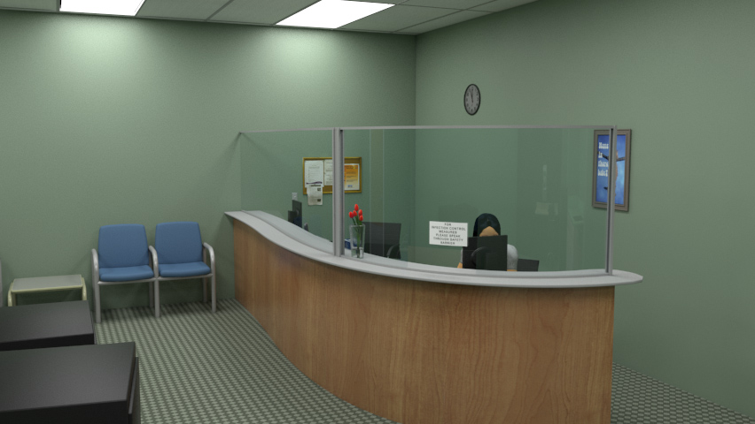
OVERVIEW
In this component, you will learn about:
the Occupational Health and Safety Act
the Internal Responsibility System (IRS)
the procedure for reporting illnesses and injuries related to work
Notes:
In this Occupational Health and Safety component of the Routine Practices module, you will learn about:
the Occupational Health and Safety Act,
the Internal Responsibility System (commonly called the “IRS”) and
the procedure for reporting illnesses and injuries that are related to work.

Slide 4
OVERVIEW
While there are many types of injuries that relate to health care, this Routine Practices component will focus on illnesses and injuries that relate to infection prevention and control.
Notes:
Occupational Health and Safety is a very important component of Routine Practices.
While there are many kinds of occupational illnesses and injuries, in this component we will focus on illnesses and injuries related to infection prevention and control.

Slide 5
OVERVIEW
After finishing this component, you will be able to:
Explain the purpose of the Occupational Health and Safety Act (“the Act”)
Identify the roles of Employers, Supervisors and Workers in the Internal Responsibility System (IRS)
Report illnesses and injuries related to work when they occur
Notes:
After finishing this component, you will be able to:
explain the purpose of the Occupational Health and Safety Act (also known as “the Act”),
identify the roles of Employers, Supervisors and Workers in the Internal Responsibility System (or IRS), and
know how to report illnesses and injuries related to work
“The Act” uses the term “Workers”. In your workplace, a health care setting, you may be called “staff” or “health care provider” or “health care worker”.
For the purposes of this component, we will use the term “Worker”.

Slide 6
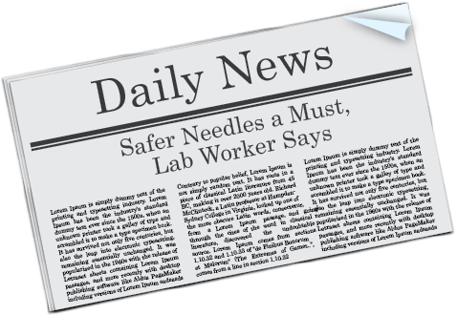
OVERVIEW
Workplace illnesses and injuries such as these are preventable.
Notes:
You may be familiar with some of these headlines:
“Safer Needles a Must,”
“Ministry Focusing on Infection Control Hazards,” or
“Influenza Immunization Saves Lives”.
By teaching you about occupational health and safety, we are trying to prevent workplace illnesses and injuries like those you’ve heard about in the news.
Notes to Trainers/Facilitators: Consider raising “Questions for Introduction” after presenting this slide.
The discussion questions for this part are the same for Acute Care, Long-term Care and Community Care. If you want to leave the questions to the end of the presentation, you can skip the following slide.

Slide 7
Discussion
Have there been illnesses or injuries related to work in your workplace?
What kind of illnesses or injuries were they?
How could they have been prevented?
Notes:
Take a moment to “stop and think” about illnesses or injuries you may have heard about in your health care setting.
Do you know a Worker who was exposed to an infectious illness or communicable disease, such as influenza or norovirus, while at work?
What kind of illnesses or injuries were they?
How can exposures be prevented?

Slide 8
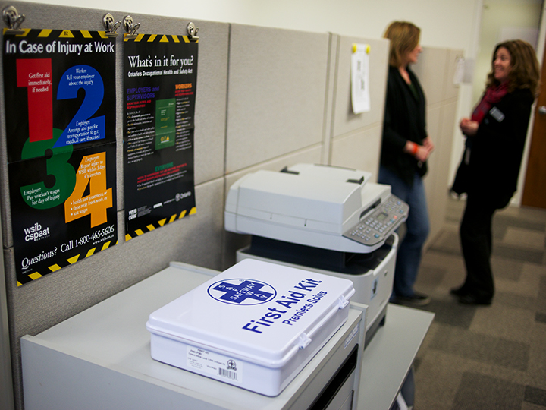
OCCUPATIONAL HEALTH & SAFETY ACT
The Occupational Health and Safety Act:
Purpose:
The Occupational Health and Safety Act provides us with the legal framework and the tools to achieve the goal of making our workplaces safe and healthy. It sets out the rights and duties of all parties in the workplace.
Employers should note that the Act makes it clear that the employers have the greatest responsibilities with respect to health and safety in the workplace. However, all workplace parties have a role and responsibility for promoting health and safety in the workplace. This is the basis for the Internal Responsibility System. Every improvement in occupational health and safety benefits all of us. Through cooperation and commitment, we can make a safer and healthier place in which to work.
Notes:
Let’s talk about our first objective, learning about the Occupational Health and Safety Act.
The Occupational Health and Safety Act provides us with the legal framework and the tools to achieve the goal of making our workplaces safe and healthy. It sets out the rights and duties of all parties in the workplace.
Employers should note that the Act makes it clear that the employers have the greatest responsibilities with respect to health and safety in the workplace. However, all workplace parties have a role and a responsibility for promoting health and safety in the workplace. This is the basis for the Internal Responsibility System. Every improvement in occupational health and safety benefits all of us. Through cooperation and commitment, we can make a safer and healthier place in which to work
Whether you are an Employer, Supervisor or Worker, you need to learn about your duties according to “the Act”.

Slide 9
OCCUPATIONAL HEALTH & SAFETY ACT
Duties of Employers under “the Act”
[Occupational Health and Safety Act, R.S.O. 1990, Chapter O.1, Section 25-26]
Employers must:
make sure workers know about hazards and dangers by providing information, instruction and supervision on how to work safely
make sure supervisors know what is required to protect workers’ health and safety on the job
create workplace health and safety policies and procedures
make sure everyone follows the law and the workplace health and safety policies and procedures
provide appropriate personal protective equipment
make sure workers wear and use the right protective equipment
do everything reasonable in the circumstances to protect workers from being hurt or getting a work-related illness
Employer
Notes:
Let’s learn more about the duties of Employers under “the Act”.
Employers must:
make sure workers know about hazards and dangers by providing information, instruction and supervision on how to work safely
make sure supervisors know what is required to protect workers’ health and safety on the job
create workplace health and safety policies and procedures
make sure everyone follows the law and the workplace health and safety policies and procedures
provide appropriate personal protective equipment
make sure workers wear and use the right protective equipment
do everything reasonable in the circumstances to protect workers from being hurt or getting a work-related illness
An infection prevention and control example of protective equipment might be Personal Protective Equipment (or PPE) and safety-engineered needles.
Employers are also required to report certain occupational injuries and illnesses. We will describe Employer reporting responsibilities in more detail later on in this component.

Slide 10
OCCUPATIONAL HEALTH & SAFETY ACT
Duties of Supervisors under “the Act”
[Occupational Health and Safety Act, R.S.O. 1990, Chapter O.1, Section 27]
Some Supervisor duties include:
educating Workers on health and safety risks
advising on health or safety risks in the workplace
ensuring Workers use or wear equipment, protective devices or clothing that is required
when a hazard has been reported, ensuring that the situation is remedied or identified with a warning sign
Supervisor
Notes:
What are some of the duties of Supervisors under “the Act”?
Supervisors are responsible to know and to help Workers to learn about health and safety risks in their workplace.
Another responsibility of Supervisors is to ensure employees use or wear equipment, protective devices or clothing that is required to keep them safe.

Slide 11
OCCUPATIONAL HEALTH & SAFETY ACT
Duties of Workers under “the Act”
[Occupational Health and Safety Act, R.S.O. 1990, Chapter O.1, Section 29]
Some Worker duties include:
following regulations and procedures
participating in education and training in the use of protective clothing, equipment or devices if required to use these
using or wearing protective equipment, devices and clothing that are required
reporting missing or broken protective devices and equipment, or other hazards
reporting injuries and illnesses acquired in the workplace
Worker
Notes:
The Worker also has responsibilities under “the Act”.
All Workers are expected to participate in training and education provided by the Employer (such as selecting and using personal protective equipment correctly) and to follow all policies and procedures put in place by your Employer.
Also, you need to report any missing or broken protective devices and equipment or other hazards.
It is important to report any injuries and illnesses you think you may have gotten in the workplace. For example, if you think you may have been exposed to a communicable disease, such as influenza or norovirus, or have picked up an infection while at work, you need to report this to your Supervisor.
Notes to Trainers/Facilitators: Consider having discussion 1 after presenting this slide.
The discussion questions for this part are the same for Acute Care, Long-term Care and Community Care. If you want to leave the questions to the end of the presentation, you can skip the following slide.

Slide 12
Discussion
What is/are my role(s)?
What are my responsibilities?
How do I use “the Act” in your daily activities?
What do I need to do under “the Act” as it relates to infection prevention and control?
Notes:
This is a “stop and think” reflection.
Take a moment to think about your roles and duties in your workplace.
Then, think about infection prevention and control, your responsibilities, and the activities you need to do to follow the Occupational Health and Safety Act.
Next, we’ll learn about the Internal Responsibility System.

Slide 13
INTERNAL RESPONSIBILITY SYSTEM
Internal Responsibility System (IRS)
A successful culture of health and safety in a workplace relies on the workplace Internal Responsibility System, or IRS.
The IRS means everyone in the workplace has a role to play and a duty to keep Workers safe.
Employer
Supervisor
IRS
Worker
Notes:
One of the primary purposes of the Occupational Health and Safety Act (OHSA) is to facilitate a strong Internal Responsibility System (IRS) in the workplace. Workplace parties’ compliance with their respective statutory duties is essential to the establishment of a strong IRS in the workplace.
Simply put, the IRS means that everyone in the workplace has a role to play in keeping workplaces safe and healthy. Workers in the workplace who see a health and safety problem such as a hazard or contravention of the OHSA have a duty to report the situation to the employer or a supervisor. Employers and supervisors are, in turn, required to acquaint workers with any hazard in the work that they do.
In Ontario, it is now second nature to put on a seatbelt every time we get into a car. We teach our children that this is important. It is part of our culture.
In Ontario workplace, health and safety needs to be part of our culture, too.
The IRS helps support a safe and healthy workplace. In addition to the workplace parties' compliance with their legal duties, the IRS is further supported by well-defined health and safety policies and programs in the workplace, including the design, control, monitoring and supervision of the work being performed.
The employer, typically represented by senior management, is responsible for ensuring that the IRS is established, promoted, and that it functions successfully. A strong IRS is an important element of a strong health and safety culture in a workplace. A strong health and safety culture shows respect for the people in the workplace.

Slide 14
INTERNAL RESPONSIBILITY SYSTEM
Roles and Responsibilities
Employers responsibilities include:
learning about safety hazards in the workplace
making workers aware of hazards
providing adequate first aid, including supplies and someone trained in first aid
Employer
IRS
Notes:
Employers have a general duty to take all reasonable precautions to protect the health and safety of the Worker. “The Act” has very specific responsibilities for the Employer to follow.

Slide 15
INTERNAL RESPONSIBILITY SYSTEM
Roles and Responsibilities
Workers responsibilities under the IRS include:
knowing about hazards in the workplace and how to do their job safely
participating in workplace health and safety and
reporting unsafe working conditions as quickly as possible
IRS
Worker
Notes:
Workers are responsible to work safely, in accordance with “the Act” and regulations. Workers need to report hazards or hazardous situations or problems to their Supervisor.

Slide 16
INTERNAL RESPONSIBILITY SYSTEM
Roles and Responsibilities
Once a hazard has been identified, the Employer and Supervisor have a duty to look at the problem and eliminate hazards that could injure Workers, or make sure that appropriate controls are in place.
Employer
Supervisor
IRS
Notes:
Employers and Supervisors together have a duty to look at hazardous problems and situations and eliminate them whenever possible or ensure appropriate controls are in place.

Slide 17
INTERNAL RESPONSIBILITY SYSTEM
Roles and Responsibilities
Employer
Supervisor
IRS
Everyone has a role in the IRS!
Worker
Notes:
Everyone has a role in the IRS!

Slide 18
INTERNAL RESPONSIBILITY SYSTEM
IRS Culture
The legal duties and responsibilities of Employers, Supervisors and Workers overlap and complement each other.
The team builds the IRS culture.
Employer
Supervisor
IRS
Worker
Notes:
The IRS is a system where everyone has direct responsibility for health and safety as an essential part of his or her job. It is a responsibility of the head of any organization or company to ensure that the entire system of direct responsibility for health and safety within the organization is established, promoted and improved over time. For an IRS to be successful everyone must be committed to health and safety as a key part of doing their job.
Following Routine Practices described in the remaining components of this module, is a good example of how Employers, Supervisors and Workers join together to build a safe workplace.
Notes to Trainers/Facilitators: Consider having discussion 2 after presenting this slide.
The discussion questions for this part are the same for Acute Care, Long-term Care and Community Care. If you want to leave the questions to the end of the presentation, you can skip the following slide.

Slide 19
Discussion
How do you contribute to the IRS?
How does your workplace demonstrate a culture of health and safety?
Notes:
Let’s “stop and think”!
How do you contribute to the Internal Responsibility System?
How does your workplace demonstrate a culture of health and safety?

Slide 20
JOINT HEALTH AND SAFETY COMMITTEE
20 or more workers
Joint Health and Safety Committee
6 to 19 workers
Health and Safety Representative
1 to 5 workers
First Aid Kit
Notes:
An important part of the internal responsibility system for health and safety, is the workplace needs to have either a Joint Health and Safety Committee or a Health and Safety representative. It depends on the size of your workplace.
If you have 20 Workers or more, your workplace must have a Joint Health and Safety Committee.
If your workplace has fewer than 20 Workers and more than 5 Workers, then your workplace needs a Health and Safety Representative.
Workplaces with 5 or fewer Workers need to have, as a minimum, a first aid kit.

Slide 21
JOINT HEALTH AND SAFETY COMMITTEE
All health care workplaces that have 20 or more employees must have a Joint Health and Safety Committee (JHSC).
The Health and Safety Representative or the Joint Health and Safety Committee where applicable contribute to workplace health and safety because of their involvement with health and safety issues, and by assessing the effectiveness of the IRS. They do this by:
identifying situations that may pose a risk to workers
making recommendations to the employer and the workers for the improvement of health and safety of the workers
obtaining information from the employer respecting identification of potential/existing hazards
For more information please review the link to the Guide to the Joint Health and Safety Committees and Health and Safety Representatives in the Workplace under the resources section.
Notes:
Let’s talk first about workplaces that have 20 or more Workers.
“The Act” requires the employer to establish a joint health and safety committee at all workplaces where 20 or more workers are regularly employed
The Health and Safety Representative or the Joint Health and Safety Committee where applicable contribute to workplace health and safety because of their involvement with health and safety issues, and by assessing the effectiveness of the IRS. They do this by:
identifying situations that may pose a risk to workers;
making recommendations to the employer and the workers for the improvement of health and safety of the workers;
obtaining information from the employer respecting identification of potential/existing hazards
For more information please review the link to the Guide to the Joint Health and Safety Committees and Health and Safety Representatives in the Workplace under the resources section.

Slide 22
JOINT HEALTH AND SAFETY COMMITTEE
Composition of the JHSC:
two co-chairs, one from management and one representing Workers
at least half of the members must be workers who do not exercise managerial functions
at least four persons for more than 50 Workers, and at least two persons for up to 50 Workers
Meetings:
The JHSC meets at least once every 3 months to
identify hazards in the workplace
make recommendations to the employer and workers about improving health and safety and
obtain information from the employer about identification of potential hazards.
Notes:
The Joint Health and Safety Committee is composed of two co-chairs, one from management and one representing Workers.
On the committee, at least half of the members must be workers who do not exercise managerial functions.
At least 4 persons are required on the Joint Health and Safety Committee for workplaces with more than 50 Workers.
If your workplace has up to 50 Workers, you need at least two persons on your Joint Health and Safety Committee.
A Health and Safety Representative needs to be designated in settings where the number of workers regularly exceeds five.
The Joint Health and Safety Committee needs to meet at least once every 3 months to make recommendations to the employer and workers about improving health and safety; receive reports from the employer on new programs and potential hazards; review reports of occupational injury or illness; and reports of inspections.

Slide 23
JOINT HEALTH AND SAFETY COMMITTEE
Health and Safety Representative
All health care settings with more than 5 employees must have a Health and Safety Representative.
In health care workplaces that have fewer than 20 but more than five employees:
Workers select a Health and Safety Representative from among the non-management Workers.
The employer must ensure that the Health and Safety Representative receives training to enable him or her to perform this role effectively.
The Representative inspects the workplace monthly and identifies situations that might be a hazard to Workers
Workplaces with one to five Workers:
do not need a Health and Safety Committee
do not need a Health and Safety Representative
Notes:
What about smaller workplaces?
If there are more than five employees but less than 20 employees in a health care workplace, the employer must ensure that workers select a Health and Safety Representative.
The Occupational Health and Safety legislation states that in work places that have fewer than 20 but more than five employees, a Health and Safety Representative needs to be selected by other employees and be from non-management.
The Health and Safety Representative is responsible to inspect the workplace monthly and identify situations that might be a hazard to Workers
For workplaces with one to five Workers, such as in a community health setting, you do not need a Joint Health and Safety Committee or a Health and Safety Representative. Your workplace should make sure that workers know how issues such as injuries or hazards are handled.
Notes to Trainers/Facilitators: Consider having discussion 3 after presenting this slide.
The discussion questions for this part are sector specific. Please select the discussion questions that are closely related to the workplace setting of your learners. If you want to leave the questions to the end of the presentation, you can skip the discussion slide.

Slide 24
Discussion for Acute Care
Do you know where your Occupational Health and Safety department is located?
What should you do after hours?
Do you know who the members of your Joint Health and Safety Committee are?
Notes:
“Stop and Think” about your Acute Care setting.
Do you know where your Occupational Health and Safety department is located?
What should you do after hours when Occupational Health and Safety is closed?
Do you know who the members of your Joint Health and Safety Committee are?
If you know the answers to these questions, you are more likely to be able to fulfill your role and be part of a health and safety team.

Slide 25
Discussion for Long-Term Care
Does your workplace have more than 20 Workers?
If you have more than 20 Workers, who are the co-chairs and members on your Joint Health and Safety Committee? How is information from the meetings shared?
Who do you report to about a workplace hazard, illness or injury during business hours and after business hours?
If your workplace has fewer than 20 Workers, who is your Health and Safety Representative and how do you contact them?
Notes:
“Stop and Think” about your health care setting.
Does your workplace have more than 20 Workers?
If you have more than 20 Workers, who are the co-chairs and members on your Joint Health and Safety Committee? How is information from the meetings shared?
Who do you report to about a workplace hazard, illness or injury during business hours and after business hours?
If your workplace has less than 20 Workers, who is your Health and Safety Representative and how do you contact them?
If you know the answers to these questions, you are more likely to be able to fulfill your role and be part of a health and safety team.

Slide 26
Discussion for Community Care
Is your workplace large enough (greater than 20 Workers) to have a Joint Health and Safety Committee?
Who would you contact if you had an occupational health and safety concern?
How would you find out who is responsible for health and safety in your workplace?
Who is your Health and Safety Representative and how do you contact him/her?
Notes:
Every Community Care setting is unique. You may provide health care in a client’s home. Or you may work in public health or provide health care in a clinic setting or an out-patient ambulatory care setting.
Your Community Care workplace may be a large provincial workplace or a smaller setting where there are fewer than 20 employees in total or perhaps your workplace has less than 5 employees.
“Stop and Think” about the following questions:
Is your workplace large enough to have a Joint Health and Safety Committee?
Who would you contact if you had an occupational health and safety concern?
How would you find out who is responsible for health and safety in your workplace?
Who is your Health and Safety Representative and how do you contact him/her?
If you know the answers to these questions, you are more likely to be able to fulfill your role and be part of a health and safety team.

Slide 27
Reporting
It is important to report illnesses or injuries that happen at a workplace.
Under the Act, occupational illness is defined as “a condition that results from exposure to a physical, chemical or biological agent to the extent that the health of the Worker is impaired and includes an occupational disease for which the worker is entitled to benefits under the Workplace Safety and Insurance Board.”
Any injury that occurs at a workplace is an occupational injury and may need to be reported.
Notes:
Reporting occupational illnesses or injuries is required under “the Act.”
In order to report, first you must understand the definition of an “Occupational Illness” according to the Occupational Health and Safety Act.
It is defined as:“a condition that results from exposure to a physical, chemical or biological agent to the extent that the health of the Worker is impaired and includes an occupational disease for which the worker is entitled to benefits under the Workplace Safety and Insurance Board.”
Any injury that occurs at a workplace is an occupational injury and may need to be reported.

Slide 28
When advised that a Worker has an occupational illness. Employers must notify the following within 4 working days:
the Joint Health and Safety Committee or Health and Safety Representative
the trade union, if any
the Ministry of Labour
Employers should be familiar with the reporting requirements, and with the information required to be included in the report.
The employer may also have obligations to the Workplace Safety and Insurance Board (WSIB).
If the illness is a reportable disease, then the Employer also must also notify the Medical Officer of Health at your local Public Health Unit according to the Health Protection and Promotion Act (Ontario Regulation 559/91).
Reporting
Notes:
Who needs to report?
Employers are responsible to report occupational illnesses or injuries in the workplace.
They must report to the following groups within 4 working days:
the Joint Health and Safety Committee or Health and Safety Representative
the trade union, if any
the Ministry of Labour
Employers should be familiar with the reporting requirements, and with the information required to be included in the report.
The employer may also have obligations to the Workplace Safety and Insurance Board (WSIB).
If the illness is a reportable disease, then the Employer must also notify the Medical Officer of Health at your local Public Health Unit according to the Health Protection and Promotion Act (Ontario Regulation 559/91).
Notes to Trainers/Facilitators:
The discussion questions for reporting are generic. They are shown in the next slide.
If you have skipped the discussions, it’s time to arrange the discussions.
Please introduce the case study after the discussions.

Slide 29
Discussion
As a Worker, what do you need to report?
To whom do you need to report?
Who is responsible for reporting to the Ministry of Labour, trade union and your occupational health service?
What does your employer have to report to the Medical Officer of Health at your local Public Health Unit?
Notes:
Take a moment to “stop and think” about reporting responsibilities.
As a Worker, what do you need to report?
To whom do you need to report?
Who is responsible for reporting to the Ministry of Labour, trade union and your occupational health service?
What does your employer have to report to the Medical Officer of Health at your local Public Health Unit?

Slide 30
SUMMARY
The Occupational Health and Safety Act sets out the duties of Employers, Supervisors and Workers to keep the workplace safe.
The Internal Responsibility System works best when everyone works together to support a culture of safety.
Injuries and illnesses related to work must be reported immediately.
Notes:
Summary
The Occupational Health and Safety Act sets out the duties of Employers, Supervisors and Workers to keep the workplace safe.
The Internal Responsibility System works best when everyone works together to support a culture of safety.
Injuries and illnesses related to work must be reported immediately.
Notes to Trainers/Facilitators: You can administer the test after presenting the summary.

Slide 31
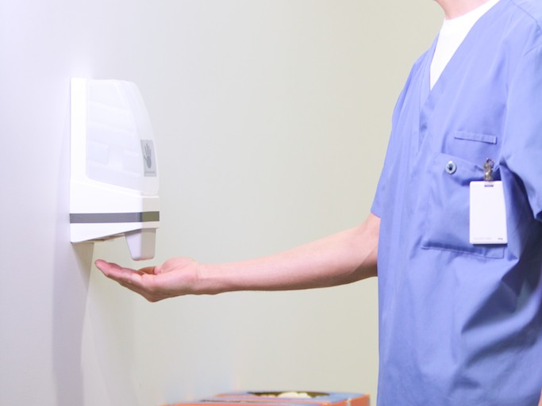
Thank you
Copyright 2014

