Slide 1
IPAC CORE COMPETENCIES ONLINE LEARNING COURSE
Routine Practices
Control of the Environment
Copyright 2014
Notes:
IPAC Core Competencies Routine Practices
Control of the Environment

Slide 2
General Introduction to Routine Practices
Routine Practices are infection prevention and control practices that are:
Used routinely during all activities
Used for all clients, patients and residents
Used in all health care settings
to help prevent and control the spread of infectious agents.
Notes:
Routine Practices are the infection prevention and control practices that must be used routinely during all activities with all clients, patients or residents, to help prevent and control the spread of infectious agents in all health care settings. No matter what health care setting you work in, routine practices always apply.

Slide 3
OVERVIEW
In this component, you will learn about:
how controlling the environment can help prevent infections
effective cleaning of the environment and equipment
Engineering Controls
Notes:
In this component, you will learn about:
how controlling the environment can help prevent infections
effective cleaning of the environment and equipment, and
Engineering Controls

Slide 4
OVERVIEW
Objectives:
After finishing this component, you will be able to:
describe factors determining accommodation and placement to prevent the transmission of infection
describe how engineering controls and facility design help reduce the risk of infection
apply appropriate environmental cleaning, linen and waste management strategies
Notes:
The objectives for this component are to:
describe factors determining clients/patients/residents accommodation and placement to prevent the transmission of infection in health care settings
describe how Engineering Controls and facility design help reduce the risk of infection, and
apply appropriate environmental cleaning, linen and waste management strategies to help reduce the risk of infection.
In your workplace you may be called staff, health care provider or health care worker.
In this component, we’ll use the term health care provider.

Slide 5
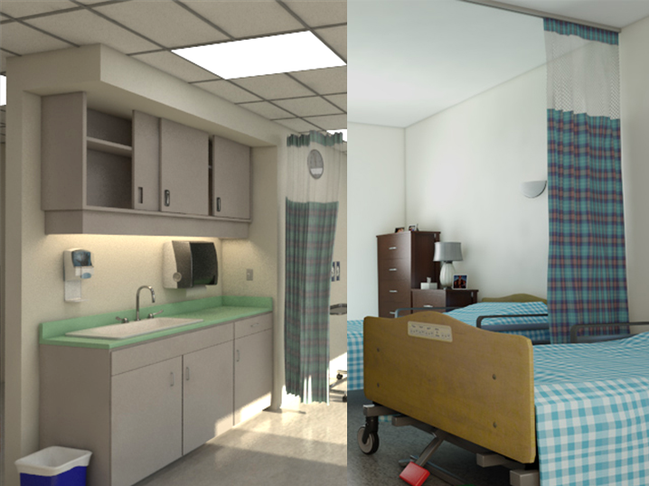
OVERVIEW
Introduction
The environment in health care is a reservoir for infectious agents. Effective control of the environment helps reduce infections and makes health care settings safer.
Notes:
Do you remember the chain of transmission? Infectious agents can be found everywhere. The environment in health care is a reservoir for infectious agents. Effective control of the environment helps reduce infections and makes health care settings safer.

Slide 6
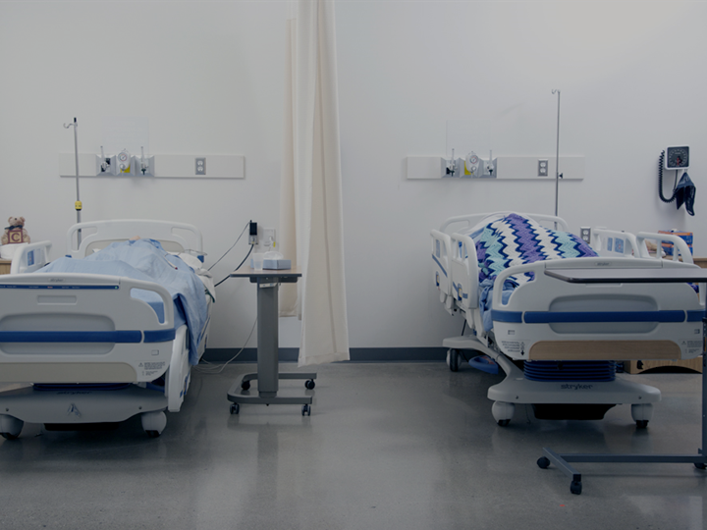
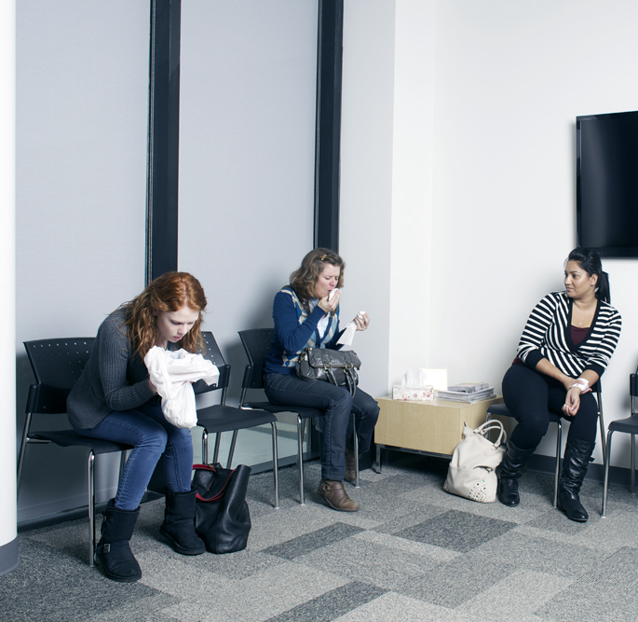
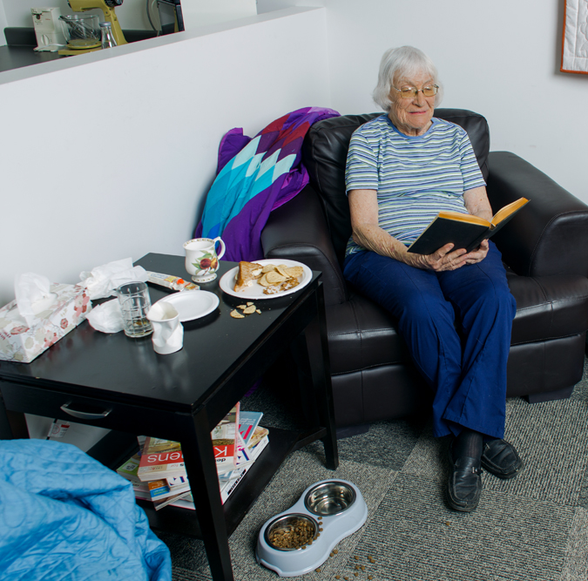
CONTROL OF THE ENVIRONMENT AND HEALTH CARE SETTINGS
Control of the Environment applies to:
health care facilities
health care settings that are not in health care facilities
Notes:
Whether you work in a large health care facility, a community clinic in an office building, a client’s home or a prehospital setting, you need to be aware of ways to control the environment to help prevent infection.

Slide 7
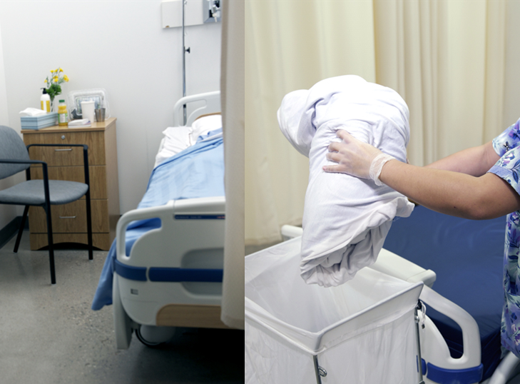
CONTROL OF THE ENVIRONMENT AND HEALTH CARE SETTINGS
Controlling the environment includes:
design measures built into the structure (preferred)
measures that health care providers implement and use
Notes:
Control of the environment includes the structural design of a health care setting, such as the number of single rooms and private bathrooms or dedicated hand-washing sinks. Incorporating design measures into the infrastructure of a healthcare setting is the preferred way to control the environment.
Environmental cleaning, linen and waste management are measures that are dependent on health care providers to implement and use, based on best practices.

Slide 8
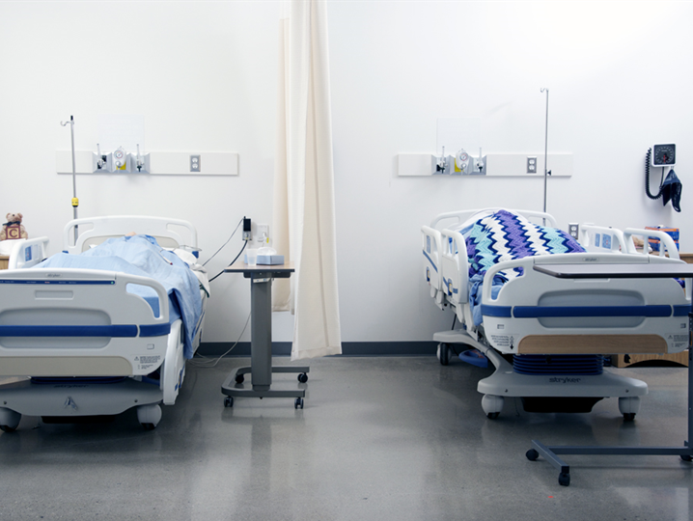
CONTROL OF THE ENVIRONMENT AND HEALTH CARE SETTINGS
Measures built into the structure include:
accommodation for clients/patients/residents
Engineering Controls
Notes:
Appropriate placement and accommodation helps to prevent the transmission of infectious agents and makes the health care environment safer.
Engineering Controls help manage risks or hazards and can also help prevent infection. This is because they are built into the physical structure to help protect you.

Slide 9
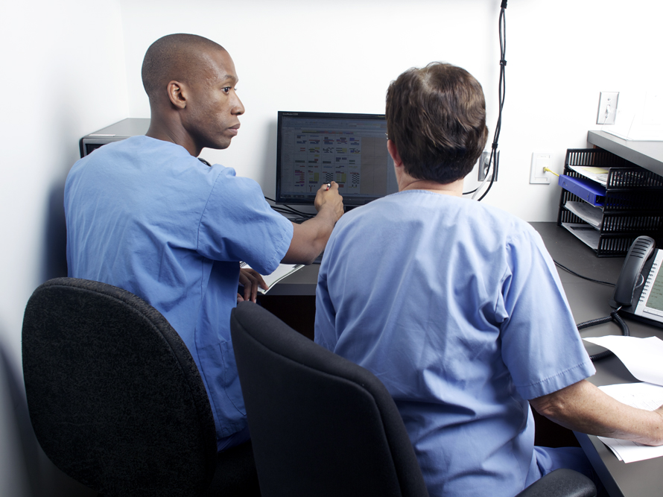
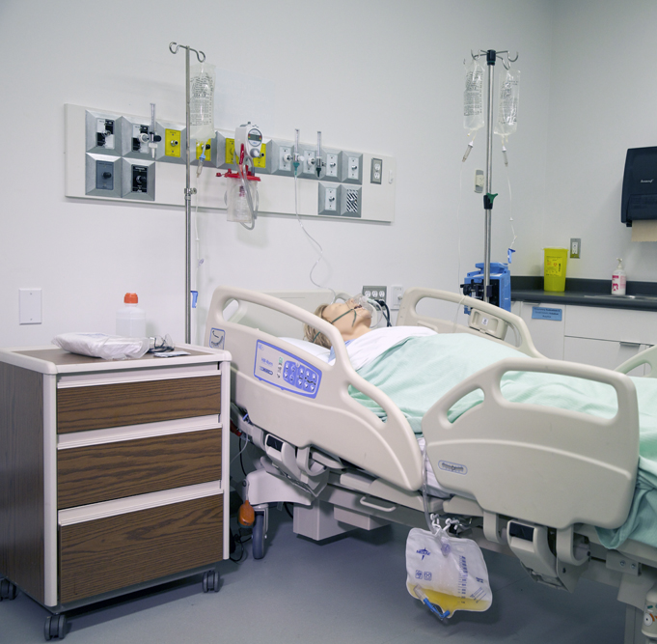
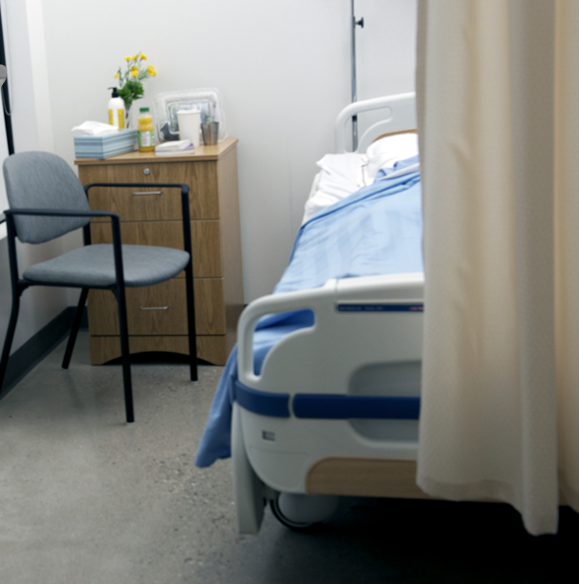
ACCOMMODATION AND PLACEMENT
The appropriate placement and accommodation helps to minimize the risk of transmission. Some key factors to consider are:
Clients, patients or residents who soil their environment can place others at risk
the availability of single rooms
Notes:
Most health care providers do not have control over the design of their health care setting. Appropriate placement and accommodation is necessary to help prevent the spread of infectious agents through the different modes.
Clients, patients or residents who soil their environment, have uncontained drainage or incontinence can place others at risk if they cannot follow directions.
Studies have shown a relationship between the use of single rooms and reduced transmission of infectious agents, but single rooms are not always available. Facilities have a fixed number of single beds and toilets. That is why we need to have policies for placement.
Special accommodation may not be practical or possible in settings such as prehospital care or home care settings.

Slide 10
Discussion
Why was the move required?
Which potential infection transmission risks were taken into consideration?

Slide 11
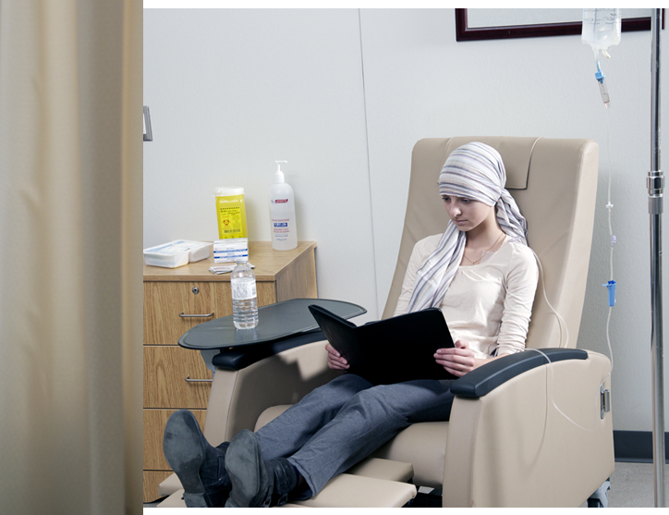
ENGINEERING CONTROLS
hand hygiene equipment
Engineering Controls:
are physical or mechanical measures put in place to help reduce the risk of infection to health care providers and/or to clients/patients/residents
are not dependent on individuals to implement
point-of-care sharps containers
physical barriers
Notes:
Engineering Controls are the physical or mechanical measures put in place in your health care setting to help reduce the risk of infection to health care providers and/or to clients, patients or residents.
For example, there may be specially engineered environments, such as a negative pressure space in a hospital, or a physical barrier in the reception area of a clinic. Dedicated hand-washing sinks placed in convenient locations are another type of Engineering Control, because they make it easier for staff to clean their hands.
For those of you who work in community settings, Engineering Controls may not be in place. Home health care providers and those who work in emergency services need to adapt the care they provide based on each unique setting. This will be discussed later in this component.

Slide 12
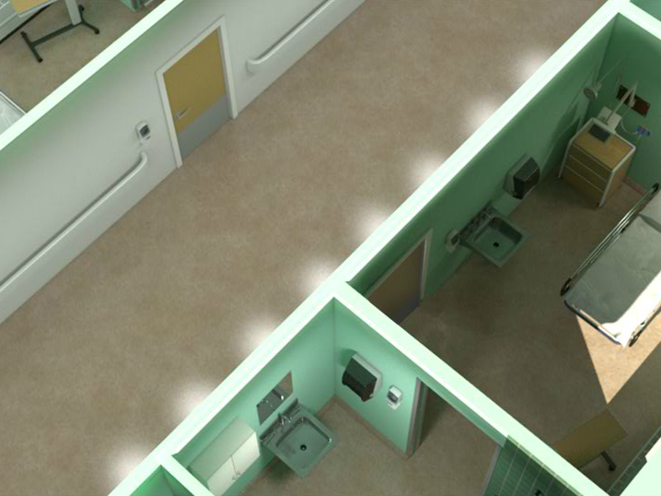
ENGINEERING CONTROLS: HVAC
Negative Pressure
Heating, ventilation and air conditioning (HVAC) systems are used and monitored to control air flow and quality in health care settings. This helps prevent infection.
Notes:
Effective HVAC systems in health care settings are important to good infection prevention and control practice and can help prevent the spread of infection.
HVAC can be specially adapted for certain high risk areas such as rooms housing individuals with airborne infections. It can also be adapted for specialty areas such as the operating rooms, medical device reprocessing areas and ambulances.
Air flow may need to be “inward” or away from the door or hallway. This is called “negative pressure”, and is used in airborne infection isolation rooms. This helps prevent infectious agents from leaving the room.

Slide 13
ENGINEERING CONTROLS: HVAC
Positive Pressure
Heating, ventilation and air conditioning (HVAC) systems are used and monitored to control air flow and quality in health care settings. This helps prevent infection.
Notes:
“Positive pressure” is when air flow is directed outwards or towards the door or hallway. This helps to keep infectious agents from entering the room.

Slide 14
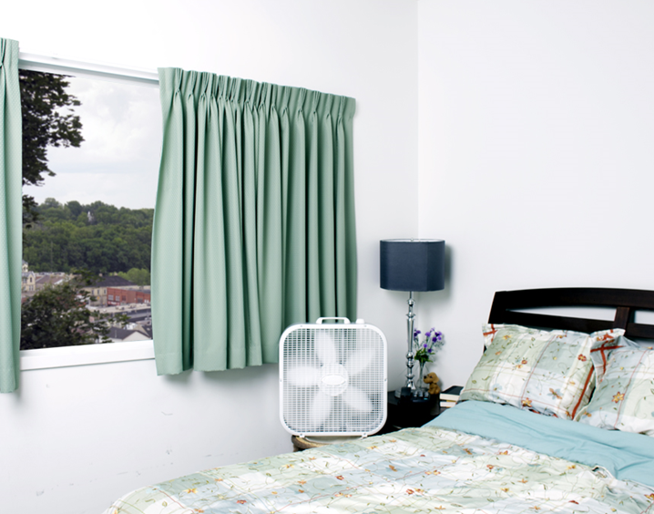
ENGINEERING CONTROLS: HVAC
Home health care and other community providers, as well as paramedics who are not in a health care facility may have limited control of the HVAC in their workplace environment.
Which of the following alternatives should you consider?
Opening or closing a window or door
Contacting your supervisor to discuss situations
Choosing alternate ways of providing care
Notes:
In community settings, such as client’s home or an office setting, you will have limited control over air circulation and temperature. We all need to work safely. For example, you might consider opening or closing a window or door in a client’s home to help with air circulation or temperature control. If you think the client’s home (or your workplace) is not safe contact your supervisor to discuss the situation. You may need to find alternate ways of providing care such as using another setting.

Slide 15
ENGINEERING CONTROLS: HAND HYGIENE EQUIPMENT
Physical barriers include:
curtains placed between beds
glass or acrylic barriers and windows in reception areas and ambulances
Physical barriers prevent the risk of transmission of infectious droplets between one person and another.
Notes:
Physical barriers are another Engineering Control in a health care setting. For example, you’ve all seen curtains between beds in emergency room multi-bed areas, clinics and hospitals, or in a long-term care setting.
Barriers are often used to protect staff from coughing clients, patients or residents in reception areas. Another example of this type of barrier is glass or acrylic barriers and windows in reception areas and ambulances.
Screens on windows are used to help prevent bugs and pests, such as mosquitoes, from entering a health care facility.
These are all examples of physical barriers that are used to help prevent the risk of transmission of infectious agents.

Slide 16
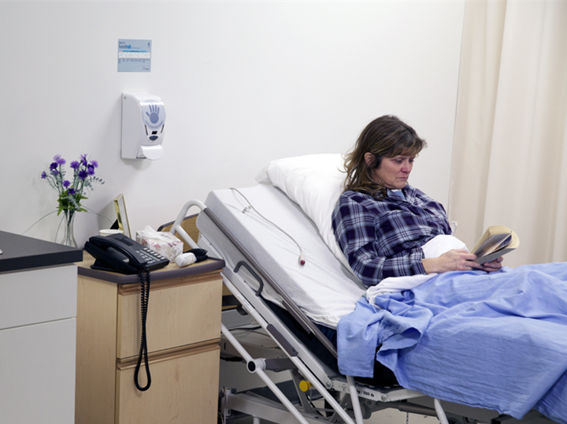
ENGINEERING CONTROLS: HAND HYGIENE EQUIPMENT
Hand hygiene equipment built into the facility includes:
point-of-care alcohol-based hand rub (ABHR)
point-of-care alcohol-based hand rub (ABHR)
Notes:
Remember: hand hygiene is an important action you can take to help prevent the transmission of infection.
Alcohol-based hand rub, or ABHR, is the “gold standard” for hand hygiene in health care when hands are not visibly soiled. It should be available for use at point-of-care, within arm’s reach of where client/patient/resident care is provided.
Ideally, dedicated "hands-free" hand washing sinks should be installed at convenient locations so that health care providers can easily use them. Along with sinks, you need liquid soap, a paper towel dispenser and a garbage bin located close to the area.
It is a good practice for home health care providers and emergency responders to carry alcohol-based hand rub with them. Towelettes should also be carried to remove soil before cleaning with ABHR.

Slide 17
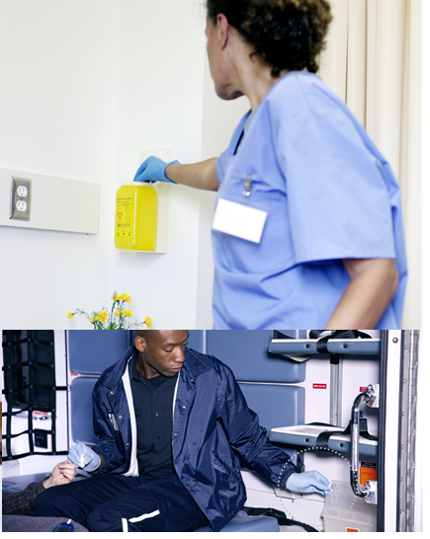
ENGINEERING CONTROLS: POINT-OF-CARE SHARPS CONTAINERS
Sharps containers need to be:
puncture-resistant
installed at point-of-care
Home/Emergency Services (ES) need to:
know how to dispose of a sharp
carry a portable sharps container
Notes:
It is important for every health care setting to provide sharps containers that are puncture-resistant and available at point-of-care.
Health care settings such as hospitals, long- term care homes and clinics install sharps containers, but health care providers who work in a client’s home or in prehospital settings need to know how they will dispose of a sharp before it is used. A portable sharps container may be an alternative.

Slide 18
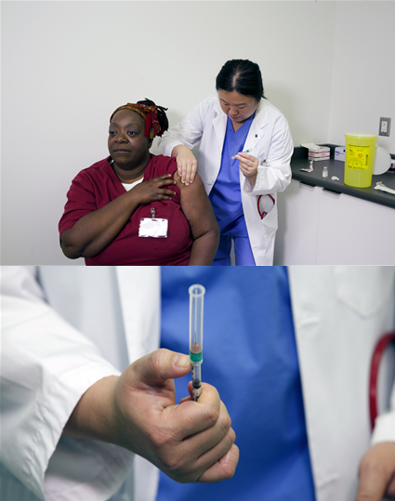
SAFE HANDLING OF SHARPS
Safe sharps management includes:
the use of safety-engineered needles and medical devices
placing puncture-resistant sharps containers at point-of-care
disposing of sharps immediately after use into puncture-resistant containers
a sharps injury prevention program
The Occupational Health and Safety Act provides requirements for sharps management.
Notes:
A sharp is an object capable of causing punctures or cuts, such as needles.
A sharps injury is an example of an occupational injury in health care. Everyone must use safety-engineered needles to protect themselves and others from injury or infection from a needle-stick or sharps injury. Use of safety-engineered needles is required for all health care providers in Ontario.
It is also important to have puncture-resistant sharps containers available at point-of-care.
Sharps injury prevention programs will be discussed in the Administrative Controls component of the Routine Practices module.

Slide 19
Discussion
What engineering controls are in your health care setting?
How have these engineering controls made your workplace safer?

Slide 20
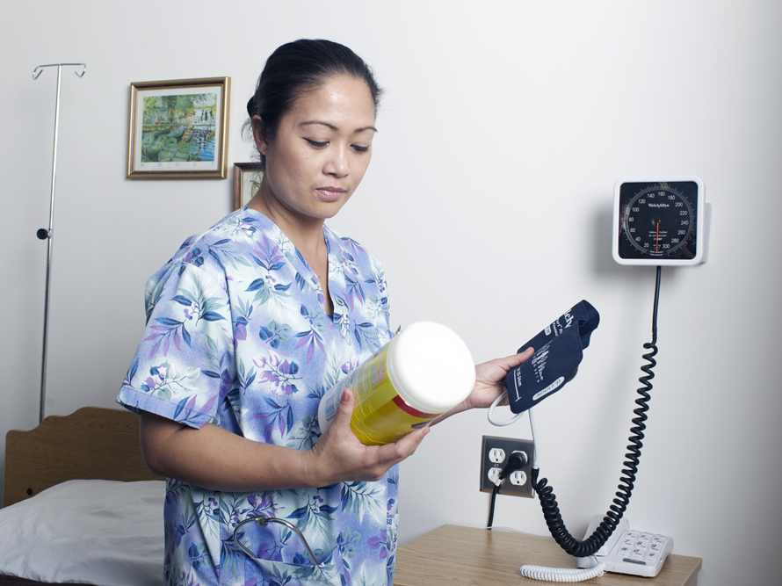
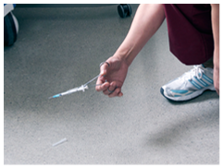
CONTROL OF THE ENVIRONMENT
Actions the health care provider can take to help control the environment are:
environment and equipment cleaning
safe sharps handling
Notes:
Now we will talk about measures that health care providers can take to control the environment to help prevent infection. You can clean the environment and equipment, and you can handle sharps safely.
Let’s start with environment and equipment cleaning.

Slide 21
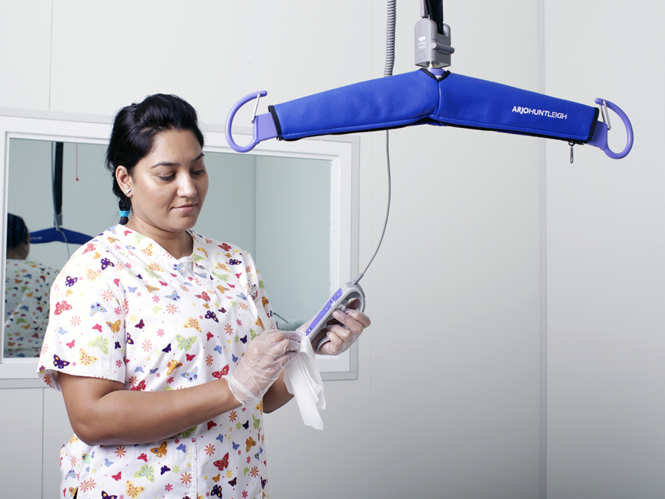
CONTROL OF THE ENVIRONMENT
Infectious agents may live on medical equipment/devices and within the health care environment.
Cleaning practices help:
provide a clean and safe health care environment
prevent infection in susceptible individuals
prevent health care-associated outbreaks
Notes:
Equipment, furniture and surfaces (that is, the environment) in a health care setting can be a source of infection in susceptible individuals and has been associated with infectious outbreaks.
Cleaning provides a safe health care environment and helps prevent the transmission of infections by reducing the number of infectious agents.

Slide 22
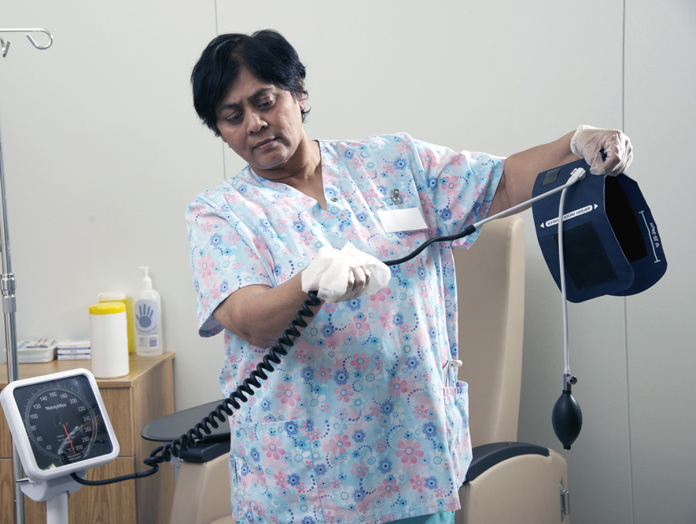
CONTROL OF THE ENVIRONMENT
Cleaning medical equipment/devices:
must be done on shared equipment between uses on different clients/patients/residents
requires cleaning and disinfection OR cleaning and sterilization
requires appropriate cleaning products and following of manufacturer’s recommendations
Notes:
Medical equipment and devices can pose a serious risk of infection if not properly cleaned between uses on clients, patients or residents.
Equipment cleaning often involves a two-step process. Clean first, then disinfect or sterilize as indicated by manufacturer’s recommendations and your policies and procedures. Medical equipment shared between clients, patients or residents (such as blood pressure cuffs or lifts) needs to be cleaned and disinfected between uses. Other medical equipment or devices (such as those used during a sterile procedure) need to be cleaned and sterilized.
Make sure you know the policies related to the correct process, what cleaning products to use and how to use them safely.

Slide 23
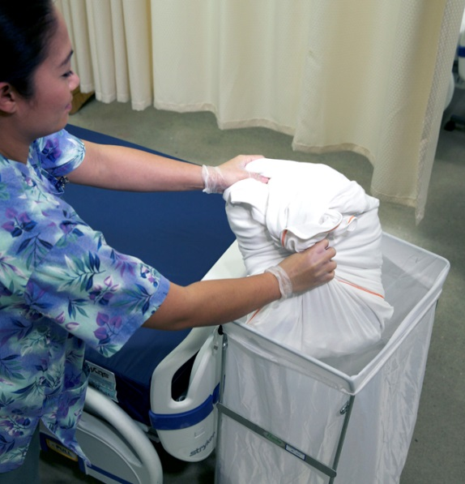
CONTROL OF THE ENVIRONMENT
Environmental cleaning includes:
cleaning of surfaces and furnishings
safe handling of soiled linen and waste (including sharps)
Notes:
A clean health care environment is important for preventing the spread of infectious agents. This includes cleaning surfaces and furnishings, safe handling of linen and waste.

Slide 24
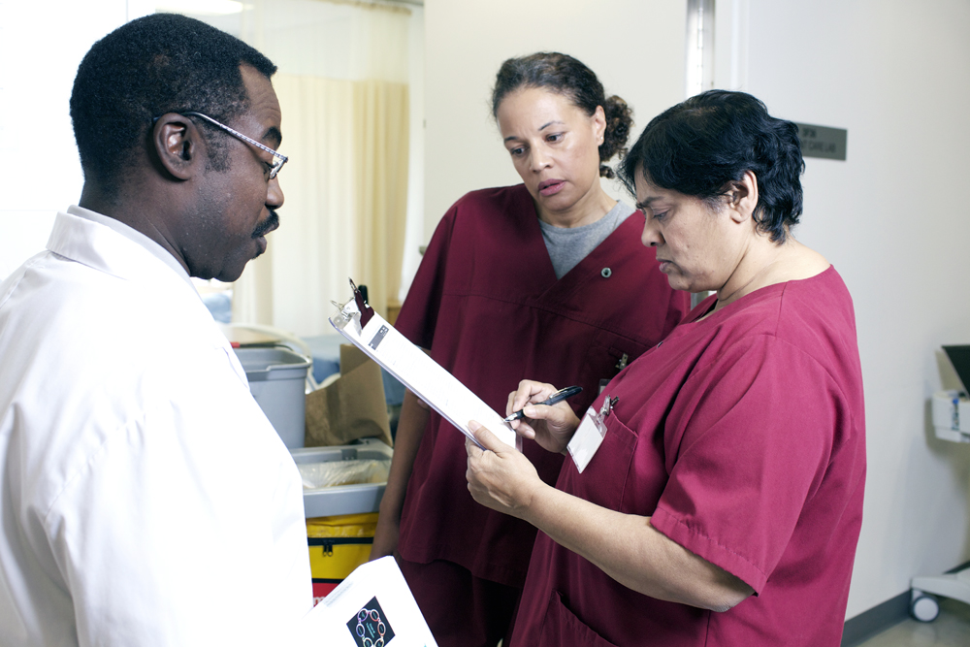
CONTROL OF THE ENVIRONMENT
Environmental cleaning should:
follow written policies and procedures
be done with approved cleaners and disinfectants
follow manufacturer’s recommendations
includes routine daily cleaning and discharge/transfer cleaning of rooms
includes auditing and feedback
Notes:
Housekeeping staff have a very important job in providing a safe environment for clients, patients or residents and healthcare providers. They need to clean according to written policies and procedures. Devoting resources to cleaning and training staff can help ensure a clean and safe health care environment.
Environmental cleaning in health care settings requires training to clean according to best practices. Training must include education about approved cleaners and disinfectants, the dilutions and contact times recommended by the manufacturer, and the PPE needed to work with these cleaners and disinfectants.
Cleaning needs to be done routinely and following discharge or transfer, as per cleaning schedules. Cleaning schedules help identify when, where and how cleaning is done.
In some cases, special cleaning routines may be required for specified infectious agents or during outbreak situations. You will learn more about this in the Additional Precautions module.
Cleaning also needs to include auditing of the practice and feedback so that everyone is involved in maintaining a clean and safe environment.

Slide 25
LINEN MANAGEMENT
To help reduce the risk of infection, linen handling practices
are put into place during collection, transport, washing and drying of linen
require risk assessment to determine the need for Personal Protective Equipment (PPE)
include safe practices for sharps handling
Notes:
Although soiled linen has rarely been linked to infection, it needs to be handled safely during collection, transport, washing and drying.
Health care providers need to do a risk assessment when handling soiled linen to determine when and how to use personal protective equipment and when to perform hand hygiene.
Soiled linen is to be handled in the same way, as a routine practice, regardless of whether linen is soiled with blood or body fluids.
Beware of sharps hiding in linen! Sharps found in linen must be reported as a health and safety incident. Safe practices are required when handling sharps.

Slide 26
To handle linen safely:
wear PPE according to your risk assessment
remove gross soil using a gloved hand and dispose of the gross soil into the toilet or hopper
handle soiled linen away from your body
roll up soiled linen and bag it at the source
contain wet linen in a dry sheet or towel before putting it in the linen bag
place soiled linen in the linen bag gently (without shaking)
tie bags securely but do not overfill them
handle bags by the tie and don’t allow the bags to contact your body
do not double bag linen or use water soluble bags
LINEN MANAGEMENT
Notes:
Your employer should provide policies and procedures on how to handle clean and soiled linen, as well as education and training on safe linen handling. This will help protect you from exposure to infectious agents.
Here are ways to handle soiled linen:
wear personal protective equipment according to your risk assessment

Slide 27
To handle linen safely:
wear PPE according to your risk assessment
remove gross soil using a gloved hand and dispose of the gross soil into the toilet or hopper
handle soiled linen away from your body
roll up soiled linen and bag it at the source
contain wet linen in a dry sheet or towel before putting it in the linen bag
place soiled linen in the linen bag gently (without shaking)
tie bags securely but do not overfill them
handle bags by the tie and don’t allow the bags to contact your body
do not double bag linen or use water soluble bags
LINEN MANAGEMENT
Notes:
remove gross soil using a gloved hand and dispose of it in the toilet or hopper

Slide 28
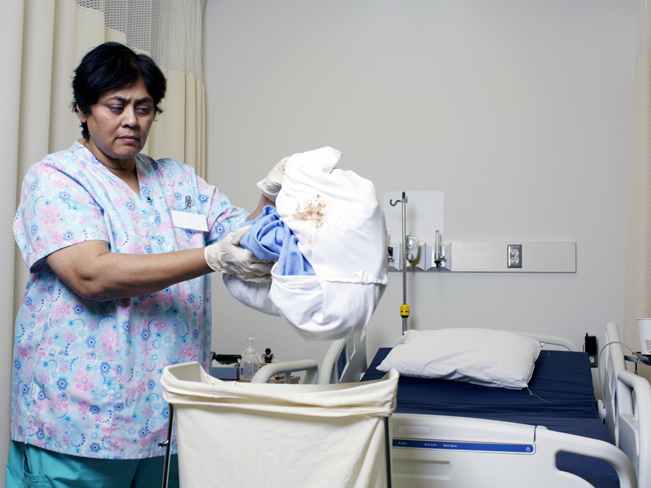
To handle linen safely:
wear PPE according to your risk assessment
remove gross soil using a gloved hand and dispose of the gross soil into the toilet or hopper
handle soiled linen away from your body
roll up soiled linen and bag it at the source
contain wet linen in a dry sheet or towel before putting it in the linen bag
place soiled linen in the linen bag gently (without shaking)
tie bags securely but do not overfill them
handle bags by the tie and don’t allow the bags to contact your body
do not double bag linen or use water soluble bags
LINEN MANAGEMENT
Notes:
handle soiled linen away from your body

Slide 29
To handle linen safely:
wear PPE according to your risk assessment
remove gross soil using a gloved hand and dispose of the gross soil into the toilet or hopper
handle soiled linen away from your body
roll up soiled linen and bag it at the source
contain wet linen in a dry sheet or towel before putting it in the linen bag
place soiled linen in the linen bag gently (without shaking)
tie bags securely but do not overfill them
handle bags by the tie and don’t allow the bags to contact your body
do not double bag linen or use water soluble bags
LINEN MANAGEMENT
Notes:
roll up soiled linen and bag it at the source

Slide 30
To handle linen safely:
wear PPE according to your risk assessment
remove gross soil using a gloved hand and dispose of the gross soil into the toilet or hopper
handle soiled linen away from your body
roll up soiled linen and bag it at the source
contain wet linen in a dry sheet or towel before putting it in the linen bag
place soiled linen in the linen bag gently (without shaking)
tie bags securely but do not overfill them
handle bags by the tie and don’t allow the bags to contact your body
do not double bag linen or use water soluble bags
LINEN MANAGEMENT
Notes:
contain wet linen in a dry sheet or towel before putting it in the linen bag

Slide 31
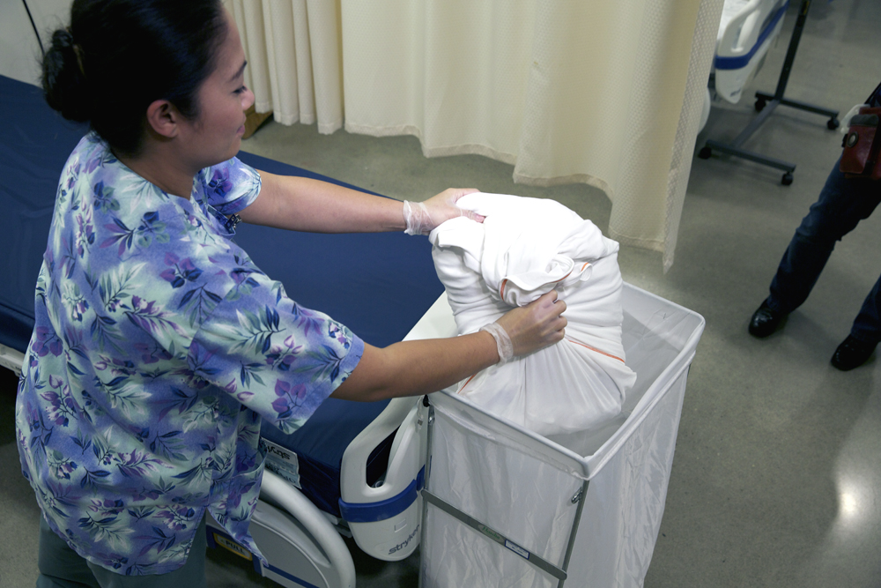
To handle linen safely:
wear PPE according to your risk assessment
remove gross soil using a gloved hand and dispose of the gross soil into the toilet or hopper
handle soiled linen away from your body
roll up soiled linen and bag it at the source
contain wet linen in a dry sheet or towel before putting it in the linen bag
place soiled linen in the linen bag gently (without shaking)
tie bags securely but do not overfill them
handle bags by the tie and don’t allow the bags to contact your body
do not double bag linen or use water soluble bags
LINEN MANAGEMENT
Notes:
place soiled linen in the linen bag gently, without shaking it

Slide 32
To handle linen safely:
wear PPE according to your risk assessment
remove gross soil using a gloved hand and dispose of the gross soil into the toilet or hopper
handle soiled linen away from your body
roll up soiled linen and bag it at the source
contain wet linen in a dry sheet or towel before putting it in the linen bag
place soiled linen in the linen bag gently (without shaking)
tie bags securely but do not overfill them
handle bags by the tie and don’t allow the bags to contact your body
do not double bag linen or use water soluble bags
LINEN MANAGEMENT
Notes:
tie bags securely, but do not overfill them

Slide 33
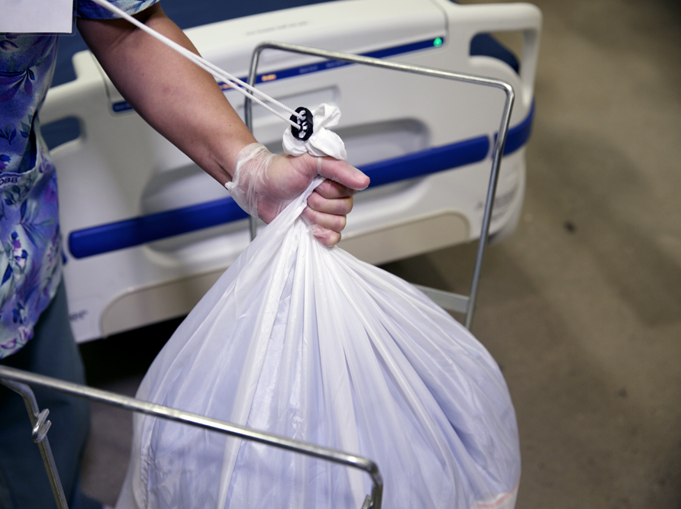
To handle linen safely:
wear PPE according to your risk assessment
remove gross soil using a gloved hand and dispose of the gross soil into the toilet or hopper
handle soiled linen away from your body
roll up soiled linen and bag it at the source
contain wet linen in a dry sheet or towel before putting it in the linen bag
place soiled linen in the linen bag gently (without shaking)
tie bags securely but do not overfill them
handle bags by the tie and don’t allow the bags to contact your body
do not double bag linen or use water soluble bags
LINEN MANAGEMENT
Notes:
handle bags by the tie, and don’t allow bags to contact your body, and

Slide 34
To handle linen safely:
wear PPE according to your risk assessment
remove gross soil using a gloved hand and dispose of the gross soil into the toilet or hopper
handle soiled linen away from your body
roll up soiled linen and bag it at the source
contain wet linen in a dry sheet or towel before putting it in the linen bag
place soiled linen in the linen bag gently (without shaking)
tie bags securely but do not overfill them
handle bags by the tie and don’t allow the bags to contact your body
do not double bag linen or use water soluble bags
LINEN MANAGEMENT
Notes:
do not double-bag linen or use water-soluble bags

Slide 35
WASTE MANAGEMENT
Two common types of waste seen in health care settings are:
general waste
biomedical waste
Health care organizations must follow relevant legislation and municipal bylaws when handling biomedical waste.
Notes:
In health care settings there are additional categories of waste that come under the heading of “biomedical waste.” Each type has to be handled according to relevant legislation, and to the municipal bylaws in your area.
Biomedical waste includes human anatomical waste; human and animal cultures or specimens; human liquid blood and blood products; items contaminated with blood or blood products that would release liquid or semi-liquid blood if compressed or squeezed; body fluids visibly contaminated with blood; sharps; and broken glass that has come into contact with blood or body fluid.

Slide 36
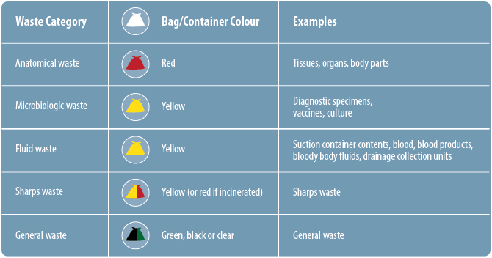
WASTE MANAGEMENT
Notes:
Let’s discuss the different types of waste.
You can see from the chart that there are five different waste categories in health care settings, each requiring its own special handling and associated with a particular colour of bag to indicate the handling required. For example, health care providers who work in the operating room need to know how to handle anatomical waste (red), and laboratory workers need to know how to handle microbiological waste (yellow).
Your organization will provide you with the information you need to handle waste safely.

Slide 37
WASTE MANAGEMENT
Health care providers should:
know the various waste categories
handle contaminated waste according to their employer’s procedures
receive hepatitis B immunization
Health care provider
Notes:
What do health care providers need to know about waste?
You need to know the various waste categories and how to handle contaminated waste. In addition, you should ensure you are immunized against hepatitis B.

Slide 38
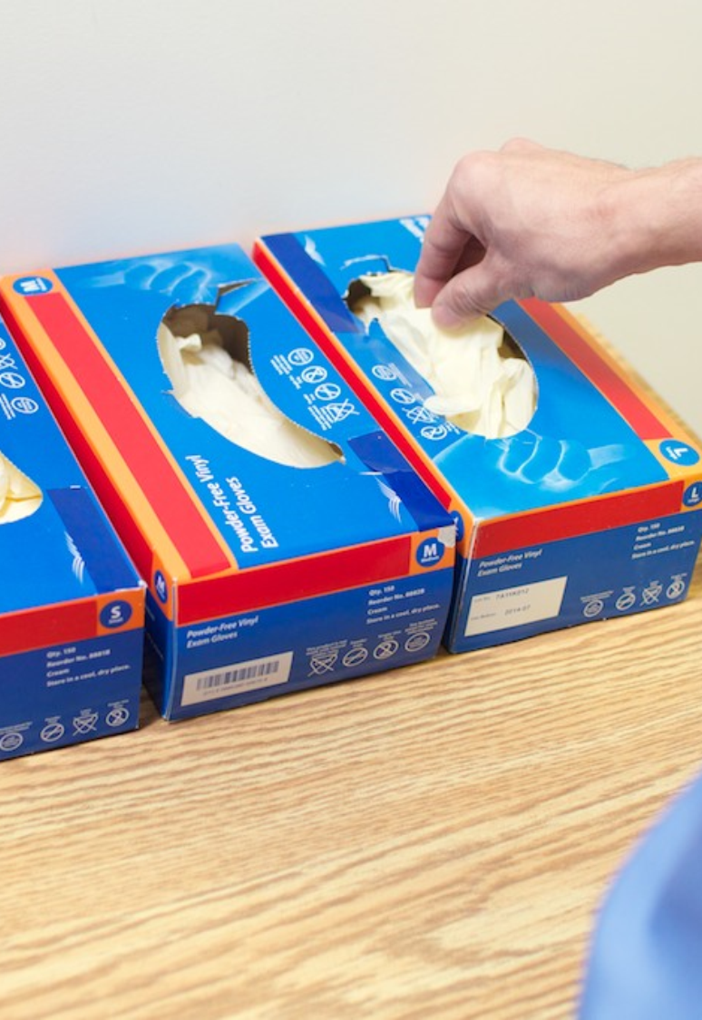
WASTE MANAGEMENT
When handling waste:
wear personal protective equipment according to the risk assessment
treat waste that contains liquid blood as fluid waste, and dispose of it in a yellow bag
close the bag when ¾ full, avoiding compression of the contents
tie the bag securely before transport
know the types of waste and requirements for special disposal
do not double bag waste unless the first bag becomes stretched or damaged
Notes:
To protect you when handling waste, perform a risk assessment and wear personal protective equipment if necessary. For example, you may need to wear gloves.

Slide 39
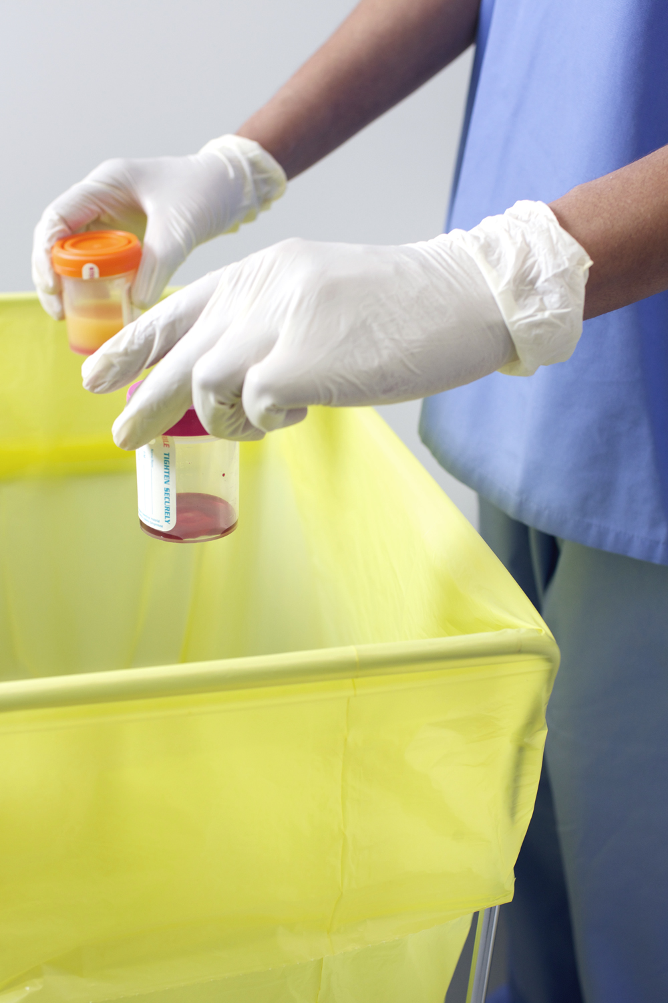
WASTE MANAGEMENT
When handling waste:
wear personal protective equipment according to the risk assessment
treat waste that contains liquid blood as fluid waste, and dispose of it in a yellow bag
close the bag when ¾ full, avoiding compression of the contents
tie the bag securely before transport
know the types of waste and requirements for special disposal
do not double bag waste unless the first bag becomes stretched or damaged
Notes:
Any time waste contains blood that could be released when the bloody item is compressed or squeezed, it needs to be disposed of in a biomedical waste or yellow bag.

Slide 40
WASTE MANAGEMENT
When handling waste:
wear personal protective equipment according to the risk assessment
treat waste that contains liquid blood as fluid waste, and dispose of it in a yellow bag
close the bag when ¾ full, avoiding compression of the contents
tie the bag securely before transport
know the types of waste and requirements for special disposal
do not double bag waste unless the first bag becomes stretched or damaged
Notes:
Avoid compressing or squeezing the contents of the bag, because it can increase your risk of a sharps injury if sharps are mistakenly placed in the bag.
Don’t overfill the bag, because it is more likely to break. Close the bag when it is three-quarters full.

Slide 41
WASTE MANAGEMENT
When handling waste:
wear personal protective equipment according to the risk assessment
treat waste that contains liquid blood as fluid waste, and dispose of it in a yellow bag
close the bag when ¾ full, avoiding compression of the contents
tie the bag securely before transport
know the types of waste and requirements for special disposal
do not double bag waste unless the first bag becomes stretched or damaged
Notes:
Always tie the bag securely before transporting to avoid spilling the bag’s contents.

Slide 42
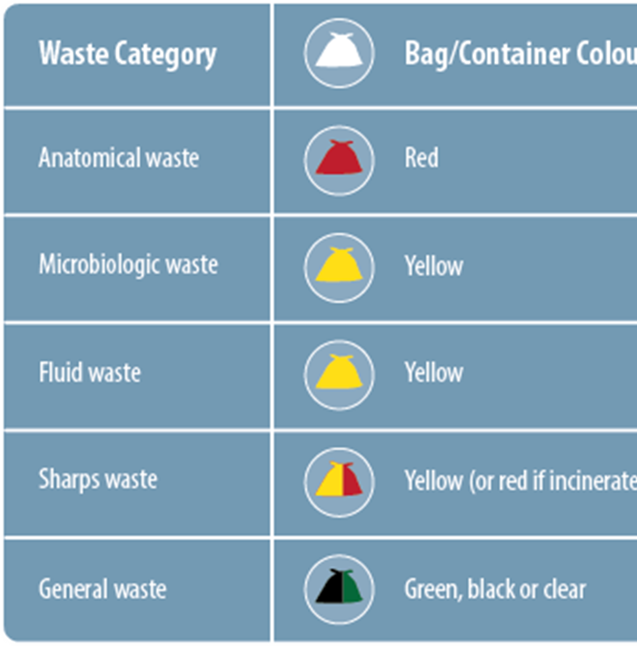
WASTE MANAGEMENT
When handling waste:
wear personal protective equipment according to the risk assessment
treat waste that contains liquid blood as fluid waste, and dispose of it in a yellow bag
close the bag when ¾ full, avoiding compression of the contents
tie the bag securely before transport
know the types of waste and requirements for special disposal
do not double bag waste unless the first bag becomes stretched or damaged
Notes:
Make sure you learn about the waste categories and requirements for disposal.

Slide 43
WASTE MANAGEMENT
When handling waste:
wear personal protective equipment according to the risk assessment
treat waste that contains liquid blood as fluid waste, and dispose of it in a yellow bag
close the bag when ¾ full, avoiding compression of the contents
tie the bag securely before transport
know the types of waste and requirements for special disposal
do not double bag waste unless the first bag becomes stretched or damaged
Notes:
There is no need to double-bag waste unless the first bag becomes stretched or damaged.

Slide 44
SUMMARY
Controlling the environment:
has been shown to help prevent infections
is influenced by the structure and design of the health care setting
includes actions by the health care provider to keep the health care environment and equipment clean and safe
Notes:
Controlling the environment:
has been shown to help prevent infections
is influenced by the structure and design of the health care setting, and
includes actions by the health care provider to keep the health care environment and equipment clean and safe.

Slide 45
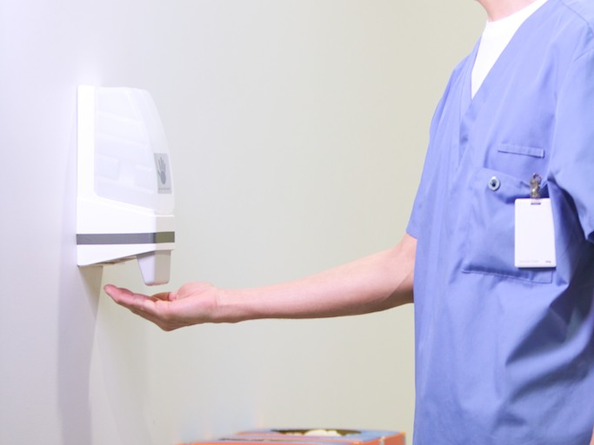
Thank you
Copyright 2014

