Slide 1
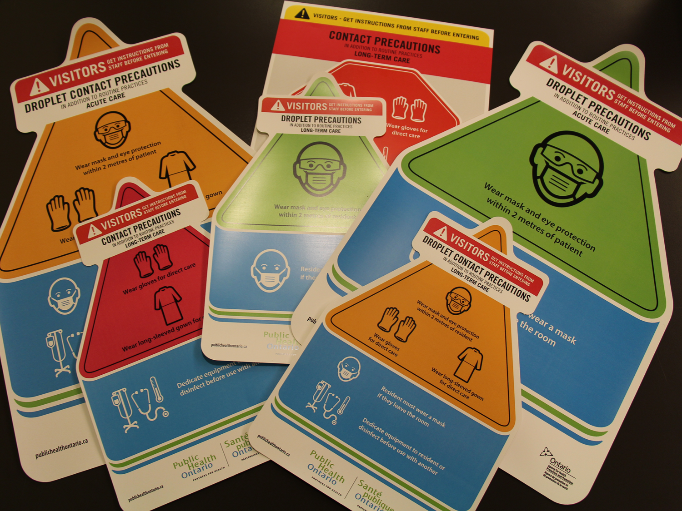
CORE COMPETENCY ADDITIONAL PRECAUTIONS
COMMUNITY CARE
Notes:
Welcome to the Infection Prevention and Control Core Competencies - “Additional Precautions”.

Slide 2
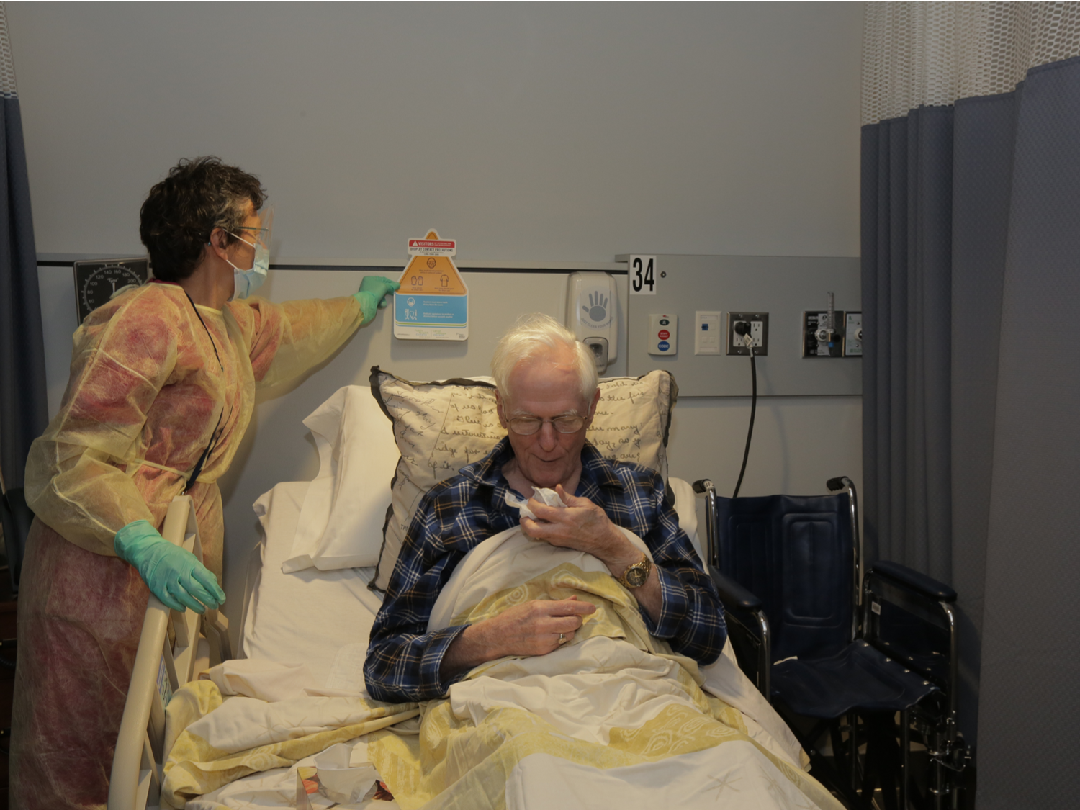
INTRODUCTION TO ADDITIONAL PRECAUTIONS
General Introduction to Additional Precautions
Additional Precautions are Infection Prevention and Control (IPAC) practices used:
in addition to Routine Practices
to interrupt the transmission of suspected or identified infectious agents
to protect health care providers and clients/residents
Notes:
Additional Precautions are Infection Prevention and Control or IPAC practices used in addition to Routine Practices. Additional Precautions interrupt the transmission of suspected or identified infectious agents. When we use Routine Practices and Additional Precautions correctly, we will help protect ourselves AND we will help protect our clients or residents from the transmission of infection.

Slide 3
OVERVIEW
In this course, you will learn about:
the principles of Additional Precautions
the categories of Additional Precautions
the elements that comprise each category of Additional Precautions
Notes:
In this course, you will learn about the principles and the categories of Additional Precautions. You will also learn about the elements that comprise each category of Additional Precautions.

Slide 4
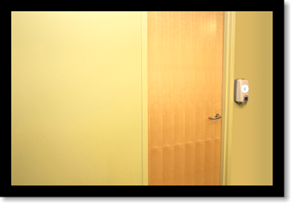
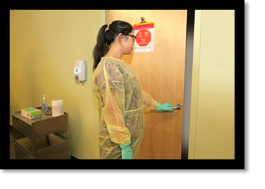
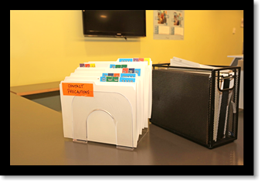
HAVE YOU EVER THOUGHT ABOUT…?
Notes:
Look at the pictures. Have you ever thought about:
Why a sign is posted on the door of a patient or resident room?
Why this health care provider is wearing gloves and a gown before entering the room?
Why there is a flag on a chart?

Slide 5
OBJECTIVES
After finishing this course, you will be able to:
describe the modes of transmission
define and describe the categories of Additional Precautions
apply the elements of Additional Precautions
Notes:
After finishing this course, you will be able to describe the modes of transmission, define and describe the categories of Additional Precautions. You will know when and how to use Additional Precautions. You will also be able to apply the principles and elements that comprise Additional Precautions.
In your workplace you may be called “staff” or “health care provider” or “health care worker”.
In this course, we’ll use the term “health care provider”.

Slide 6
MODE OF TRANSMISSION
The three modes of transmission are:
Infectious Agents
Contact
Susceptible Host
Reservoirs
CHAIN
OF
TRANSMISSION
Droplet
Portal of Entry
Portal of Exit
Airborne
Mode of Transmission
Notes:
Do you remember the Chain of Transmission in the Routine Practices Core Competencies Course? In healthcare, there are three common modes of transmission. They are Contact, Droplet and Airborne.

Slide 7
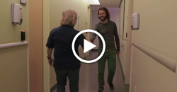
CONTACT TRANSMISSION
Direct Contact
Transmission occurs through one person touching another person.
If you can’t access the video click here to download all of the Core AP videos.
Notes:
There are two types of contact transmission: direct contact and indirect contact.
Direct contact transmission occurs through one person touching another person.

Slide 8
Notes:
Infectious agents are transferred through contaminated objects or environments.
Examples of organisms that can be transmitted by contact are norovirus and many antibiotic-resistant organisms.

Slide 9
Notes:
Droplet transmission occurs when droplets carrying an infectious agent exit the respiratory tract of a person and come in contact with the mucous membranes (such as the eyes, nose and mouth) of another person. Mumps and pertussis are examples of droplet transmission.

Slide 10
DROPLETS
What do you know about droplets?
T
F
F
Droplets travel on air currents.
or
T
F
T
Droplets remain on horizontal surfaces.
or
Facts about droplets
Droplets:
do not remain in the air
may contain infectious agents
usually travel less than 2 metres
Infectious agents in droplets:
can land on surfaces
can contaminate the environment
Can live on surfaces for long periods of time
Notes:
What do you know about droplets?
Droplets travel on air currents. Is it true or false?
Droplets remain on horizontal surfaces? Is this true or false?
Here are some key facts about droplet transmission. When we cough or sneeze, we release droplets.
Droplets do not remain in the air, may contain infectious agents and usually travel less than two metres. Infectious agents in droplets can land on surfaces, contaminate the environment and can live on surfaces for long periods of time.

Slide 11
Notes:
Airborne transmission occurs when airborne particles remain suspended in the air, travel on air currents and are then inhaled by susceptible people who may be nearby or some distance away from the infected person.
Tuberculosis, chickenpox and measles are airborne.

Slide 12
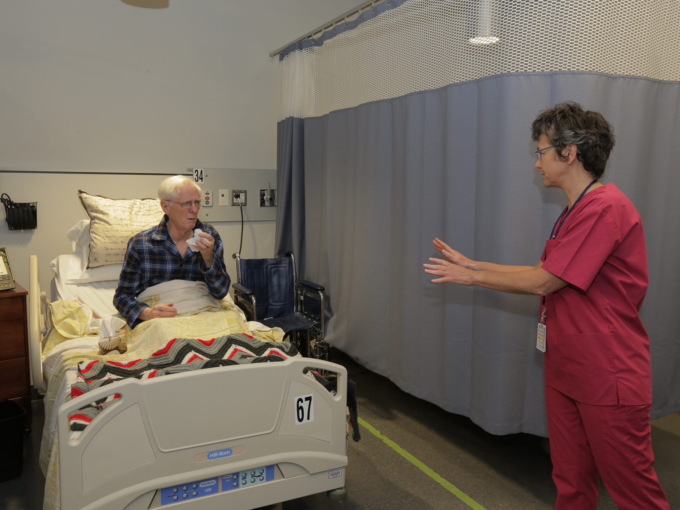
ADDITIONAL PRECAUTIONS
are used in addition to Routine Practices
are based on the mode of transmission
include Contact Precautions, Droplet Precautions and Airborne Precautions
may be combined depending on the infectious agents
Notes:
Additional Precautions are infection prevention and control measures used to manage certain known or suspect infectious agents. They are used when Routine Practices alone are not sufficient to prevent and control spread.
Additional Precautions are based on the mode of transmission.
There are three categories of Additional Precautions: Contact Precautions, Droplet Precautions and Airborne Precautions. Sometimes Additional Precautions are combined, depending on the infection or infectious agents.

Slide 13
STOP AND THINK
How do Additional Precautions relate to Routine Practices?
Notes:
Now it's time to stop & think. How do Additional Precautions relate to Routine Practices?

Slide 14
COMBINATIONS OF ADDITIONAL PRECAUTIONS
Which category/categories of Additional Precautions would help to prevent and control the spread of influenza?
How is influenza spread?
Which category/categories of Additional Precautions would help to prevent and control the transmission of croup?
How is croup transmitted?
When more than one mode of transmission of an infectious agent exists, use a combination of Additional Precautions
Most respiratory infections ⇒droplet + contact
Notes:
How is influenza spread? Which category or categories of Additional Precautions would help to prevent and control the spread of influenza?
How is croup transmitted? Which category or categories of Additional Precautions would help to prevent and control the transmission of croup?
Sometimes more than one mode of transmission exists for a particular infectious agent, so, more than one type of precautions would be needed.
Most respiratory infections need droplet-contact precautions since they are spread by both droplet and contact transmission.
When combinations of precautions are used, all elements of each type of precautions need to be applied.

Slide 15
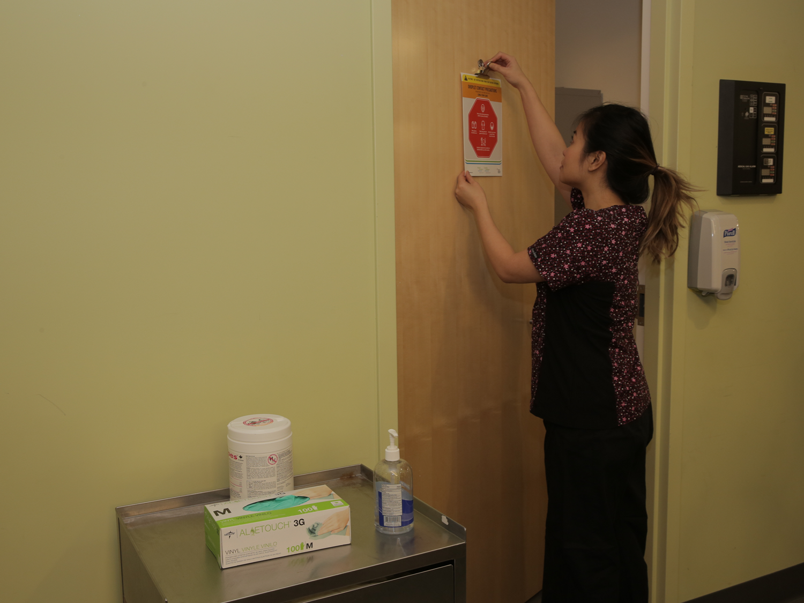
INITIATING ADDITIONAL PRECAUTIONS
Additional Precautions need to be initiated:
as soon as symptoms appear, not only when an infectious disease is diagnosed
by any regulated health care professional
based on your health care setting’s policies
Notes:
Additional Precautions must be initiated as soon as symptoms suggestive of a potentially transmissible infection are noted, not only when an infectious disease diagnosis is confirmed.
The initiation of Additional Precautions can be done be any regulated health care professional. This may include an RN, an RPN, a physician or an Infection Control Professional.
Each health care setting should have a policy regarding initiation of the appropriate Additional Precautions at the onset of symptoms.
Do you know the procedure or protocol you need to follow for a rash with no known cause or new onset fever, cough and shortness of breath?
Whenever Additional Precautions are initiated, the person responsible for infection prevention and control must be notified. He or she will verify that the precautions are appropriate.

Slide 16
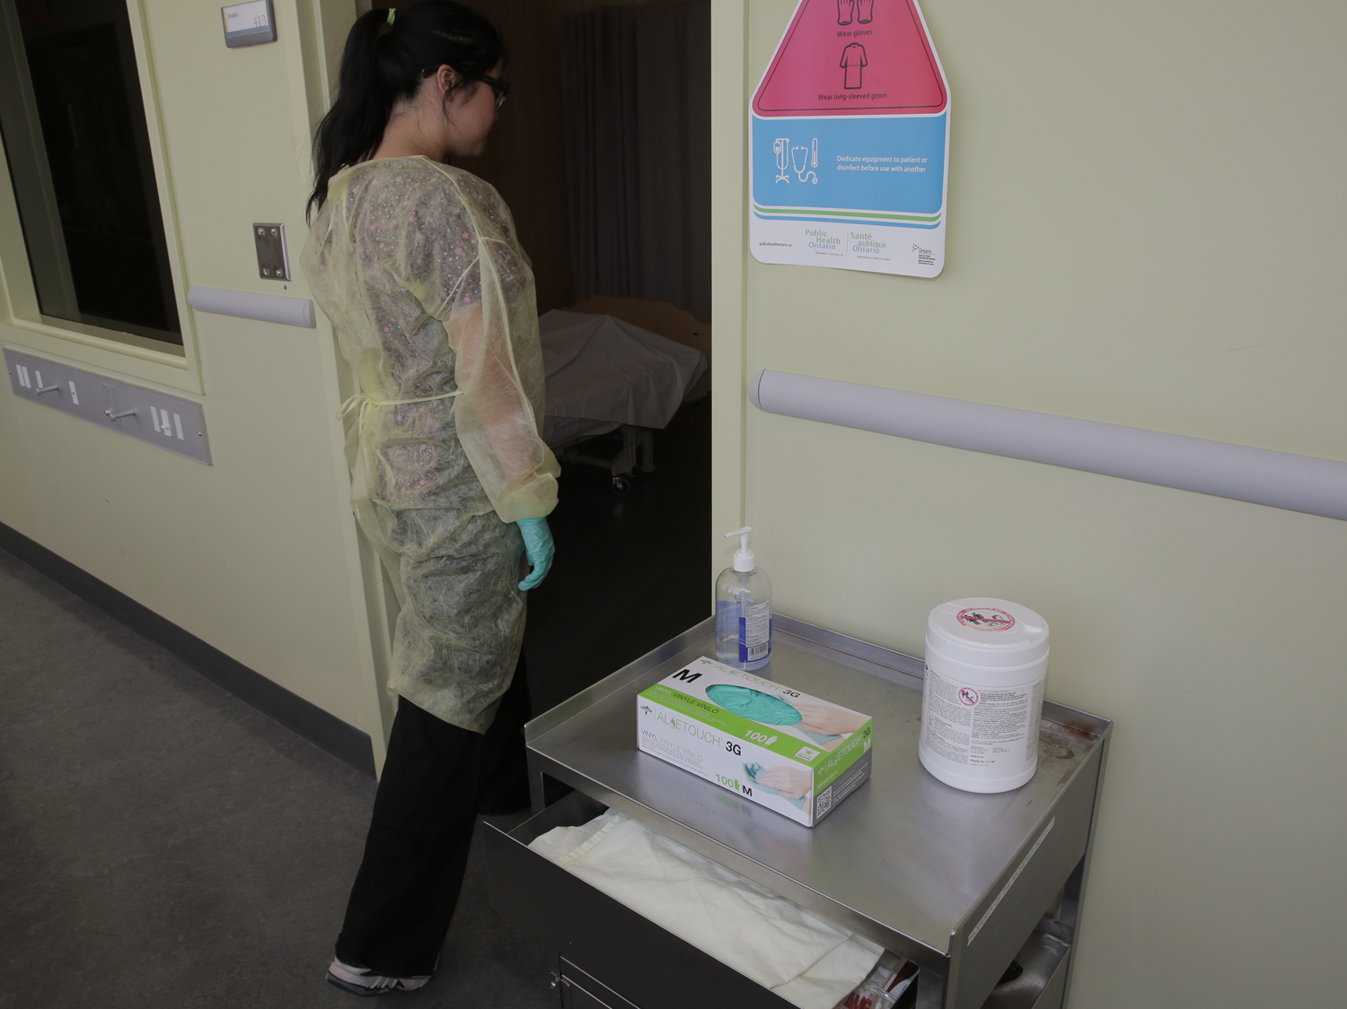
MAINTAINING ADDITIONAL PRECAUTIONS
Additional Precautions need to be reviewed and maintained until:
there is no longer a risk of transmission
discontinued by the person responsible for infection control
laboratory results are available to confirm or rule out the diagnosis
Notes:
Regular reviews by the person responsible for infection control may be done to determine when there is no longer a risk of transmission.
Additional Precautions need to be maintained until they are discontinued by a physician, infection control professional or designate.
Laboratory results may confirm or rule out the diagnosis.
Remember that being placed in a single room or remaining on Additional Precautions may impact a patient or resident’s well-being. All efforts should be made to maintain their quality of care.

Slide 17
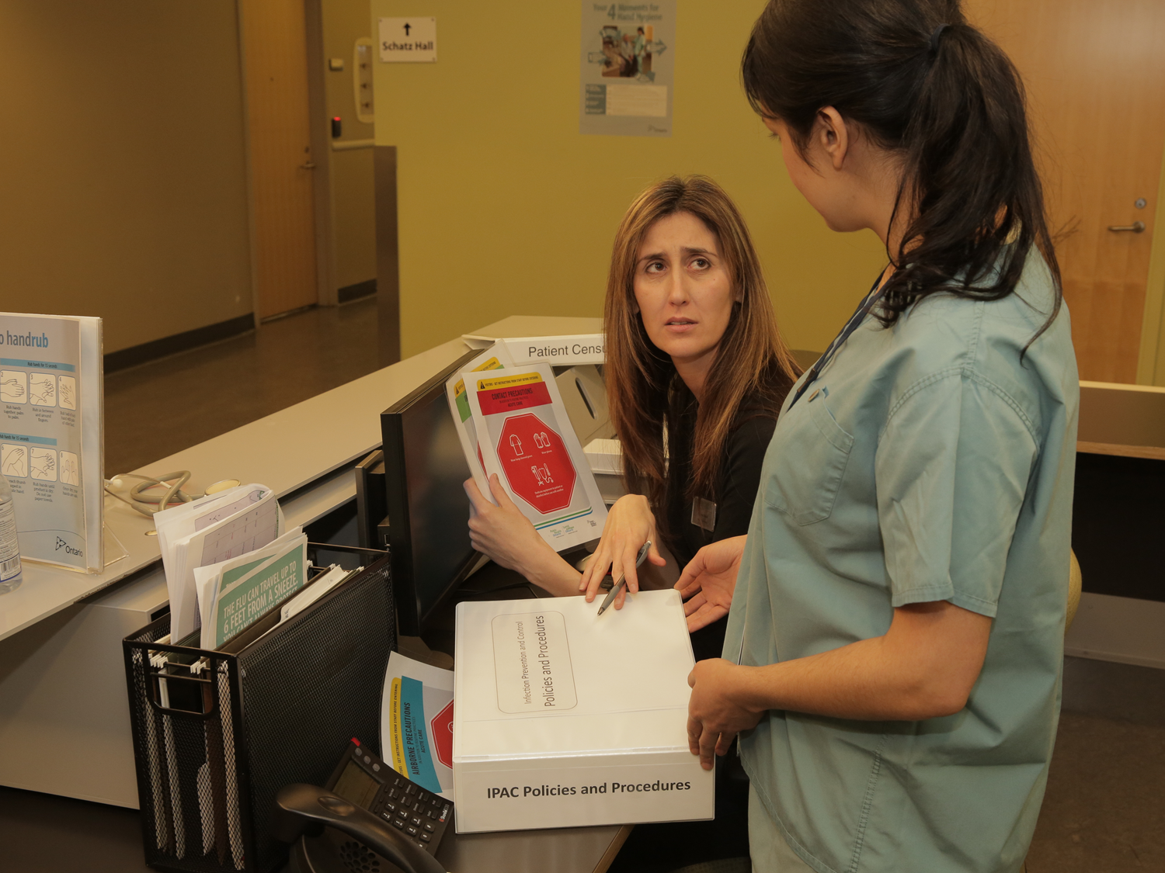
DISCONTINUATION OF ADDITIONAL PRECAUTIONS
Discontinuation of Additional Precautions:
should be done as soon as the risk of transmission is no longer present
must follow the policies of the health care setting
is done by the person responsible for Infection Prevention and Control or his/her designate
may require discussion with the attending physician
Notes:
The discontinuation of Additional Precautions should be done as soon as safely possible and when the risk of transmission is no longer present.
Each health care setting should have a policy regarding the factors to consider when discontinuing Additional Precautions.
The Infection Control Professional must be consulted prior to discontinuation of Additional Precautions and, in some cases, discussion with the attending physician may be needed.

Slide 18
POLICIES AND PROCEDURES OF ADDITIONAL PRECAUTIONS
Policies and procedures related to Additional Precautions may vary from organization to organization.
They may depend on:
the health care setting
the client/patient/resident population
the organization’s history of dealing with infections
Modifications necessary for medical or therapeutic purposes
Always:
follow your organization’s policies and procedures
contact your Infection Control Professional or designate to help with decision making
Notes:
Policies and procedures related to Additional Precautions may vary from organization to organization. They may depend on the health care setting, the client or patient population, the organization’s history of dealing with infections.
It may be necessary to modify Additional Precautions for medical or therapeutic purposes.
Always follow your organization’s policies and procedures and contact your Infection Control Professional or designate to help with decision making.

Slide 19
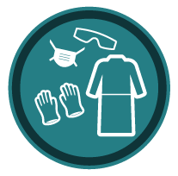
ELEMENTS OF CONTACT PRECAUTIONS - CC
Accommodation
Clinic setting
place clients into an examination room or cubicle
Home health care setting
no restrictions on accommodation
Notes:
Accommodation
In the community clinic setting, clients requiring Contact Precautions need to be identified when they arrive at the clinic and placed into an examination room or cubicle as soon as available.
In the home health care setting there are no restrictions on accommodation.

Slide 20
ELEMENTS OF CONTACT PRECAUTIONS - CC
Signage
Clinic setting
flag chart
Home health care setting
flag chart
Notes:
Signage
In clinic settings, flag the chart. In home health care settings, flag the client’s chart. Also flag the client record in the office to alert other service providers about the need for Contact Precautions.

Slide 21
ELEMENTS OF CONTACT PRECAUTIONS - CC
PPE
Clinic setting
gloves and gown for direct care
Home health care setting
gloves and gown for direct care
Notes:
PPE
In both the clinic setting and home care setting, wear gloves and a gown for direct care where the health care provider’s skin or clothing may come in direct contact with the client or items in the client’s room or bed space.

Slide 22
ELEMENTS OF CONTACT PRECAUTIONS - CC
Cleaning (Part 1)
Clinic setting
routine cleaning
clean high-touch surfaces daily
special cleaning for has Vancomycin Resistant Enterococcus (VRE) or Clostridium difficile (C. difficile)
Notes:
Cleaning
In the clinic setting, routine environmental cleaning is sufficient. All high-touch surfaces must be cleaned daily. If the client requires Contact Precautions because they have Vancomycin Resistant Enterococcus (VRE) or Clostridium difficile (C. difficile) special cleaning will be required.

Slide 23
ELEMENTS OF CONTACT PRECAUTIONS - CC
Cleaning (Part 2)
Home health care setting
routine household cleaning
household cleaners or a dilute bleach solution may be used to disinfect the bathroom
Notes:
Cleaning
In the home setting, routine household cleaning is sufficient. The use of household cleaners or dilute bleach solutions may be used to disinfect the bathroom.

Slide 24
ELEMENTS OF CONTACT PRECAUTIONS - CC
Equipment
Clinic setting
clean according to Routine Practices
Home health care setting
dedicate equipment
clean according to Routine Practices
Notes:
Equipment
Remember Routine Practices. Any equipment that is shared between clients needs to be cleaned and disinfected after each use and before being used with another client.
In the home health care setting, equipment that is used for clients on Contact Precautions should be dedicated to that client. As a routine practice, clean and disinfect equipment after each use and before being used with another client.

Slide 25
ELEMENTS OF CONTACT PRECAUTIONS - CC
Communication to:
patients or clients
families (if necessary)
other facilities
transport services prior to transfer
Notes:
Communication
It is important that you tell patients or clients (and their families if necessary) why Contact Precautions are in place. Teach family members about the use of contact precautions and their risk of exposure. Also ensure that other departments, facilities or transport service providers are aware of the need for Contact Precautions.

Slide 26
ELEMENTS OF CONTACT PRECAUTIONS - CC
Transport
gloves and gowns for direct contact
clean and disinfect equipment used for transport
Notes:
Transport
If the client needs to be transported by ambulance, transportation staff will need to wear gloves and a gown for direct contact during the transport. As always, clean and disinfect equipment used for transport.

Slide 27
ELEMENTS OF CONTACT PRECAUTIONS - CC
Visitors
education regarding hand hygiene
Notes:
Visitors
Visitors should be taught when and how to perform hand hygiene.

Slide 28
ELEMENTS OF DROPLET PRECAUTIONS - CC
Accommodation (Part 1)
Clinic setting
screen for respiratory symptoms
assess as soon as possible
move into examination room
maintain two-metre distance between patients until an examination room is available
Notes:
Accommodation
In the clinic setting, the patient should self-screen for respiratory symptoms. This could be done (through use of a poster at the clinic entrance). Respiratory screening needs to be done before they enter the clinic, when making an appointment, or, upon their arrival. If a patient has respiratory symptoms, he or she should be asked to clean their hands, be given a mask to wear, and immediately be moved into an examination room. If this is not possible, maintain a two-metre distance between the symptomatic patient and other waiting patients. See the symptomatic patient as soon as possible.

Slide 29
ELEMENTS OF DROPLET PRECAUTIONS - CC
Accommodation (Part 2)
Home health care setting
discuss maintaining a two metre distance from the symptomatic client
Notes:
Accommodation
In the home health care setting, the client and their household members should be counselled about keeping a two-metre or six-foot distance between the client and others.

Slide 30
ELEMENTS OF DROPLET PRECAUTIONS - CC
Signage
Clinic setting
flag chart
at the entrance to the examination room
Home health care setting
flag chart
Notes:
Signage
In clinic settings, flag the chart and post a Droplet Precautions sign at the entrance to the examination room.
In home health care settings, flag the client’s chart. Also flag the client record in the office to alert other service providers about the need for Droplet Precautions.

Slide 31
ELEMENTS OF DROPLET PRECAUTIONS - CC
PPE
wear facial protection (mask and eye protection) within two metres of the patient or client
Notes:
PPE
When you are within two metres of the symptomatic patient or client you must wear a mask and eye protection.

Slide 32
ELEMENTS OF DROPLET PRECAUTIONS - CC
Cleaning
Clinic setting
routine cleaning
clean high-touch surfaces after client leaves examination room
Home health care setting
routine cleaning
Notes:
Cleaning
Follow routine environmental cleaning practices.
After the patient leaves the examination room, clean high-touch and other surfaces that the patient may have touched, with a low-level disinfectant before placing another patient in the room.
In the home, follow routine household cleaning practices.

Slide 33
ELEMENTS OF DROPLET PRECAUTIONS - CC
Equipment
Clinic setting
clean according to Routine Practices
Home health care setting
dedicate
clean according to Routine Practices
Notes:
Equipment
Remember Routine Practices. Any equipment that is shared between patients or clients needs to be cleaned and disinfected after each use and before being used with another client.
In the home health care setting, equipment that is used for clients on Droplet Precautions should be dedicated to that client. As a routine practice, clean and disinfect equipment after each use and before being used with another client.

Slide 34
ELEMENTS OF DROPLET PRECAUTIONS - CC
Communication to:
patients or clients
families (if necessary)
other departments
other facilities
transport services prior to transfer
Notes:
Communication
It is important that you tell patients or clients (and their families if necessary) why Droplet Precautions are in place. Teach family members about the use of Droplet Precautions and their risk of exposure. Also ensure that other departments, facilities and transport service providers are aware of the need for Droplet Precautions.

Slide 35
ELEMENTS OF DROPLET PRECAUTIONS - CC
Transport
patient or client wears a mask OR health care providers wear mask and eye protection
Notes:
Transport
If the patient or client needs to be transported from the clinic or home setting, they should wear a mask if tolerated. If the patient or client is unable to tolerate the mask, then, the health care staff transporting them must wear a mask and eye protection.

Slide 36
ELEMENTS OF DROPLET PRECAUTIONS - CC
Visitors
education regarding hand hygiene and the risk of exposure
keep two metres away from symptomatic client
Notes:
Visitors
Family members should receive education about hand hygiene and the risk of exposure. If visitors are present they should be counselled about keeping two metres away from the symptomatic client.

Slide 37
ELEMENTS OF AIRBORNE PRECAUTIONS - CC
Accommodation (Part 1)
Clinic setting
end of day appointments (preferred)
airborne infection isolation room or alternate arrangements
examination room door closed
allow time for air exchanges when patient leaves
Notes:
Accommodation
Patients with suspected airborne illnesses should be seen at the end of the day if possible. They should be given a mask to wear while they are within the clinic setting and placed in an airborne infection isolation room. If this is not available, the clinic staff should consider making arrangements to see the patient in a setting where an airborne infection isolation room is available.
In the clinic setting, the door to the examination room should remain closed until there have been sufficient air exchanges to clear the room of all airborne contaminants.

Slide 38
ELEMENTS OF AIRBORNE PRECAUTIONS - CC
Accommodation (Part 2)
Home health care setting
not applicable for home care
Notes:
Accommodation
Airborne infection isolation rooms are not available in homes. Clients are free to move about their home.

Slide 39
ELEMENTS OF AIRBORNE PRECAUTIONS - CC
Signage
Clinic setting
flag the chart
on the door of the examination room
Home health care setting
flag the chart
Notes:
Signage
The patient’s chart should be flagged to alert health care providers about the need to follow Airborne Precautions.
When a patient on Airborne Precautions is in an examination room, there should be an Airborne Precautions or alert sign on the door.
In home healthcare setting, flag the chart kept in the home and the client record in the office. This helps alert other service providers about the need for Airborne Precautions.

Slide 40
ELEMENTS OF AIRBORNE PRECAUTIONS - CC
PPE (Part 1)
Tuberculosis (pulmonary TB)
wear fit-tested, seal-checked N95 respirator for entry to client's home or clinic examination room
infectious TB clients need to wear a mask when outside of their home.
Notes:
PPE
The need for PPE while caring for patients or clients on Airborne Precautions will depend on why the patient or client is on precautions.
For patients or clients with confirmed or suspected tuberculosis (TB) you must wear a fit-tested, seal-checked N95 respirator to enter the clinic examination room or the client’s home. Clients with tuberculosis should wear a mask whenever they leave their home. There is never an indication for patients or clients to wear an N95 respirator.

Slide 41
ELEMENTS OF AIRBORNE PRECAUTIONS - CC
PPE (Part 2)
Measles, varicella (chickenpox)
only immune staff to enter home or clinic room
N95 respirator not required if immune
Notes:
PPE
For patients or clients with measles or varicella (chickenpox), it is preferred that only staff who have documented immunity to the particular disease enters the clinic examination room or client’s home. If you are immune, you do not need to wear an N95 respirator. However, if you do not have documented immunity, then, you must wear a fit-tested, seal-checked N95 respirator.

Slide 42
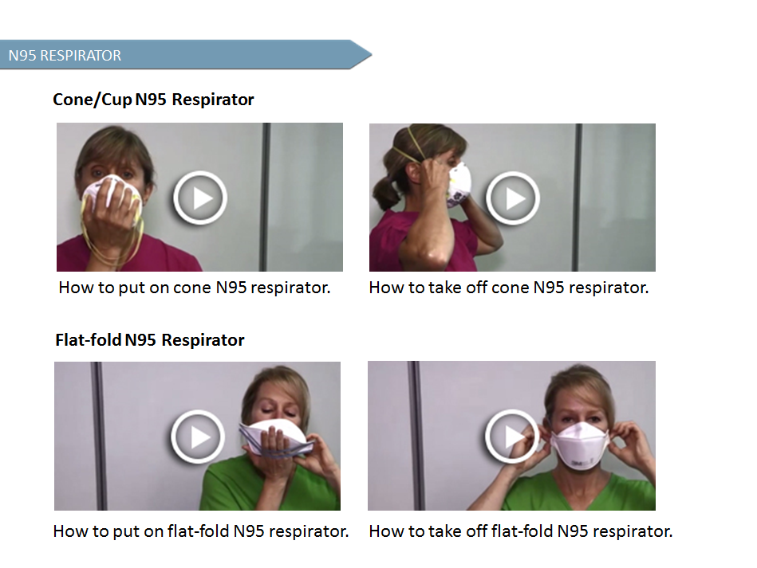

Slide 43
ELEMENTS OF AIRBORNE PRECAUTIONS - CC
Cleaning in Clinics and Homes
routine cleaning
Notes:
Cleaning
Follow routine environmental cleaning practices in the clinic and routine household cleaning in the home.

Slide 44
ELEMENTS OF AIRBORNE PRECAUTIONS - CC
Equipment
follow Routine Practices
Notes:
Equipment
Follow Routine Practices for use and cleaning of shared medical equipment.

Slide 45
ELEMENTS OF AIRBORNE PRECAUTIONS - CC
Communication to:
patient or client
patient or client family (if necessary)
other departments or other facilities
transport services prior to transfer
Notes:
Communication
It is important that you tell patients or clients (and their families if necessary) why Airborne Precautions are in place.
Ensure that other departments, facilities and transport service providers are aware of the need for Airborne Precautions.

Slide 46
ELEMENTS OF AIRBORNE PRECAUTIONS - CC
Transport
clients to wear a mask during transport
staff to wear N95 respirator
Notes:
Transport
If patients or clients need to be transported, then, they must wear a mask during the transport and staff transporting them must wear an N95 fit-tested, seal-checked respirator during the transport.

Slide 47
ELEMENTS OF AIRBORNE PRECAUTIONS - CC
Visitors
discourage visitor from visiting
counsel about risk of exposure
wear an N95 respirator
Notes:
Visitors
Discourage visitors from visiting.
Visitors should be counselled about their risk and wear an N95 respirator with good fit characteristics. They will need to be taught how to perform a seal-check.
For clients on precautions due to measles or varicella, visitors who are known to be immune do not need to wear an N95 respirator to visit.
People who are not household contacts and are not immune should not visit.

Slide 48
STOP AND THINK
How have you used Additional Precautions?
What are some of the challenges you have experienced using Additional Precautions?
How would you overcome those challenges?

Slide 49
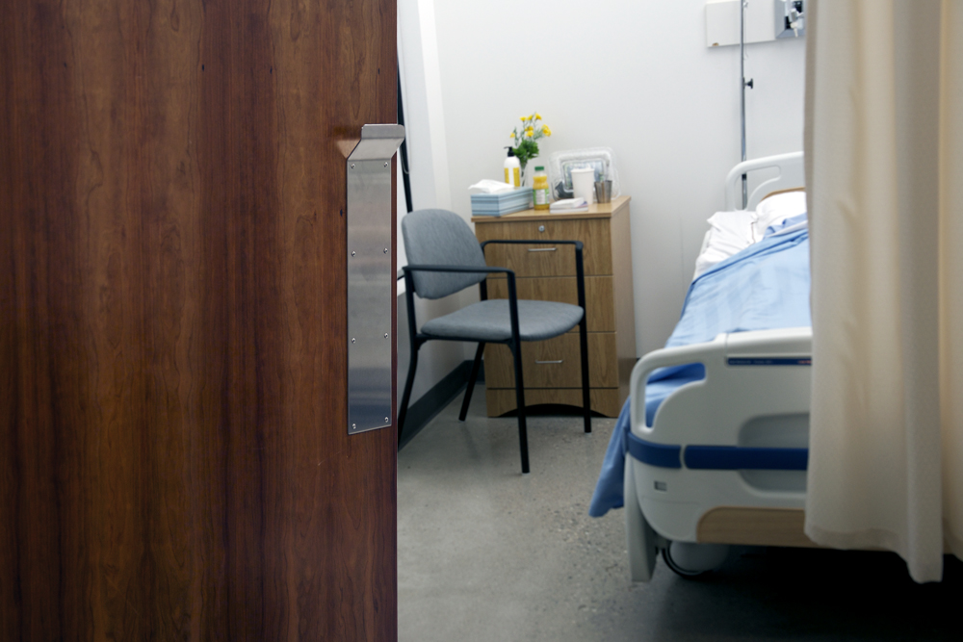
SUMMARY
Additional precautions are used in addition to Routine Practices when Routine Practices are not sufficient to prevent and control the transmission of infectious agents.
Categories of Additional Precautions are Contact, Droplet and Airborne. They may also be used in combination.
Elements of Additional Precautions may include accommodation, signage, Personal Protective Equipment (PPE), dedicated equipment, additional cleaning measures, limited transport and communication.
Additional Precautions should be initiated as soon as symptoms suggestive of a transmissible infection are noted, not only when a diagnosis is confirmed. Precautions need to remain in place until there is no longer a risk of transmission of infection.
Notes:
Let’s summarize some of the key principles of Additional Precautions. Additional Precautions are used in addition to Routine Practices when Routine Practices are not sufficient to prevent and control the transmission of infectious agents.
The three categories of Additional Precautions are Contact, Airborne and Droplet Precautions and these may be used in combination.
Elements of Additional Precautions may include accommodation, signage, Personal Protective Equipment or PPE, dedicated equipment, additional cleaning measures, limited transport and communication.
Initiate Additional Precautions as soon as symptoms suggestive of a transmissible infection are noted, not only when a diagnosis is confirmed. Additional Precautions should remain in place until there is no longer a risk of transmission of infection.

