Slide 1
IPAC CORE COMPETENCIES ONLINE LEARNING COURSE
Routine Practices
Administrative Controls
Copyright 2014
Notes:
Welcome to IPAC Core Competencies Routine Practices Administrative Controls

Slide 2
General Introduction to Routine Practices
Routine Practices are infection prevention and control practices that are:
Used routinely during all activities
Used for all clients, patients and residents
Used in all health care settings
to help prevent and control the spread of infectious agents.
Notes:
Routine Practices are the infection prevention and control practices that must be used routinely during all activities with all clients, patients or residents, to help prevent and control the spread of infectious agents in all health care settings. No matter what health care setting you work in, routine practices always apply.

Slide 3
OVERVIEW
An important element of Routine Practices is Administrative Controls.
In this component, you will learn about:
how Administrative Controls help protect health care providers and clients/patients/residents from infection
the effectiveness of Administrative Controls depends on their consistent implementation by management and health care providers
Notes:
An important element of Routine Practices is Administrative Controls.
Administrative Controls are built into the operations or the “day-to-day” work of every health care setting.
In this component, you will learn about how Administrative Controls help protect health care providers and clients, patients or residents from infection. The effectiveness of Administrative Controls depends on their consistent implementation by management and health care providers.

Slide 4
OVERVIEW
Objectives:
After finishing this component, you will be able to:
identify Administrative Controls in the health care setting
describe and apply Administrative Controls to prevent and control infection in your health care setting
Notes:
After finishing this component, you will be able to identify Administrative Controls in your health care setting and describe the role of Administrative Controls in the prevention and control of infection.
You will also learn how you can use Administrative Controls in your role and in your setting.
Note that in your workplace, you may be referred to as staff or a health care worker or a health care provider. In this component, we’ll use the term health care provider.

Slide 5
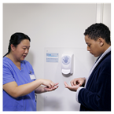
OVERVIEW
Introduction
Administrative Controls are measures that the administration of a health care setting puts into place to help protect health care providers and clients/patients/residents from infection.
Administrative Controls include:
infection prevention and control policies and procedures
healthy workplace policies
health care provider education
education of clients/patients/residents
healthy workplace initiatives
Notes:
Administrative Controls include:
infection prevention and control policies and procedures
healthy workplace policies such as work exclusion and visitor restriction
health care provider education
education of clients, patients or residents
healthy workplace initiatives, such as: immunization programs, occupational health and hygiene

Slide 6
POLICIES & PROCEDURES
Policies and procedures for infection prevention and control must be:
evidence-based and consistent with legislation and standards
established by the employer to guide safe care and practices
relevant to the health care setting and accessible
followed by all health care providers
reviewed and updated on a regular basis
communicated to health care providers through training
developed in conjunction with Infection Prevention and Control, Occupational Health and Safety and the Joint Health and Safety Committee.
Notes:
Effective infection prevention and control policies and procedures will give you the knowledge you need to carry out your tasks safely.
When policies and procedures are evidence-based and consistent with legislation and standards, they promote best practice and ensure a consistent approach to infection prevention and control.
Policies and procedures (or “P and Ps”) for infection prevention and control must also be:
established by the employer to guide safe care and practices
relevant to the health care setting and accessible, and
followed by all health care providers (compliance must be monitored)
Policies and procedures should be current, with a plan in place to review and update on a regular basis.
All health care providers should receive training on the policies and procedures that are relevant to their work.
Remember that infection prevention and control “policies and procedures” should be developed in conjunction with Infection Prevention and Control, Occupational Health and Safety and the Joint Health and Safety Committee.

Slide 7
INFECTION PREVENTION AND CONTROL EDUCATION AND TRAINING
Infection prevention and control education and training needs to be part of orientation and ongoing scheduled education for health care providers.
Notes:
All health care providers need to know about Routine Practices so they can incorporate them into their daily work
Education in Routine Practices should be included in your initial orientation program and ongoing staff development.

Slide 8
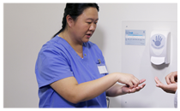
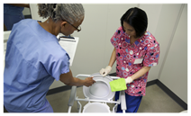
INFECTION PREVENTION AND CONTROL EDUCATION AND TRAINING
Employers should provide training on Routine Practices and Additional Precautions, which includes:
chain of transmission
hand hygiene
risk assessment
the use of personal protective equipment (PPE)
cleaning and disinfection
healthy workplace policies
Notes:
Employers should provide training on Routine Practices and Additional Precautions, which includes:
chain of transmission
hand hygiene
risk assessment
the use of personal protective equipment, or PPE
cleaning and disinfection and
healthy workplace policies

Slide 9
Discussion
What educational sessions related to infection prevention and control have you attended in the last year?

Slide 10
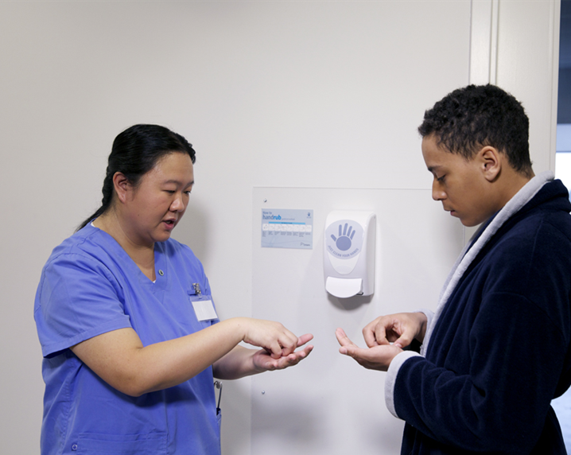
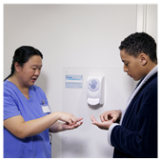
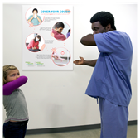
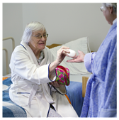
INFECTION PREVENTION AND CONTROL EDUCATION AND TRAINING
Client/patient/resident teaching should include:
when and how to do hand hygiene
cover your cough
not sharing personal items
infection prevention and control precautions and practices
Notes:
Clients, patients and residents should be educated, too.
Important topics for them to understand include learning about correct hand hygiene technique and basic hygiene practices that prevent the spread of infectious agents.
Everyone should learn about respiratory etiquette.
Clients, patients and residents should be taught not to share personal items when they are in a health care setting.
It is important to involve clients, patients and residents in the infection prevention and control precautions and practices related to their care.

Slide 11
Discussion
What materials are available to help your clients/patients/residents learn about how to protect themselves from infection?

Slide 12
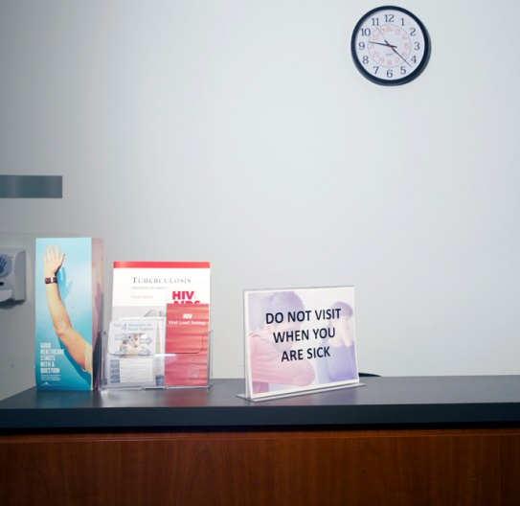
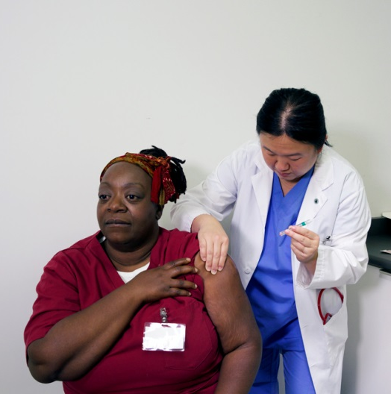
HEALTHY WORKPLACE - POLICIES
Healthy workplace policies include:
work exclusion
visitor restriction
immunization
Notes:
Healthy workplace policies establish clear expectations that encourage the wellness and safety of health care providers, as well as clients, patients and residents.
They include work exclusion policies, policies restricting visitors who are ill and immunization programs.

Slide 13
HEALTHY WORKPLACE – WORK EXLUSION
A health care provider work exclusion policy needs to include:
directions about not working when ill with a potentially communicable disease
education for health care providers about:
self-screening for signs and symptoms of communicable diseases
reporting an illness
returning to work after an illness
work exclusion
Notes:
Your health care setting should have a healthy workplace policy that reinforces not going to work when you are ill with a potentially communicable disease. This is known as a work exclusion policy.
It is important for health care providers to know what to do when they are ill with an infectious agent.
Make screening yourself for infection a habit before each shift.
Examples of possible communicable diseases include influenza-like illness, acute respiratory infection (fever, new cough), gastroenteritis (vomiting, diarrhea), rashes and conjunctivitis (or pink eye).
You should know the work exclusion policy in your health care setting, how to report an illness and the process for returning to work after a communicable illness.

Slide 14
HEALTHY WORKPLACE – VISITOR RESTRICTION
Health care providers should:
be alert to visitors with symptoms of an infection and provide direction and education about the risks of transmitting infection
advise family members and visitors to postpone their visit if they are ill with symptoms of an infection
visitor restriction
Notes:
A healthy workplace policy should discourage people who are ill with a communicable disease from visiting. It is important to provide education about the visitor exclusion policy to both visitors and health care providers.
Be alert to visitors with symptoms of infection and provide direction and education about how to prevent the transmission of infection.
Health care providers should advise family members and visitors to postpone their visit if they are ill with symptoms of infection such as fever, new cough, vomiting or diarrhea.

Slide 15
HEALTHY WORKPLACE – IMMUNIZATION POLICIES
"Immunization is one of the most effective ways to protect clients/patients/residents and health care providers from getting vaccine-preventable diseases." - Provincial Infectious Diseases Advisory Committee (PIDAC)
immunization policies
Notes:
PIDAC (Provincial Infectious Diseases Advisory Committee) says: “One of the most effective preventive measures to protect clients/patients/residents and staff from acquiring communicable diseases is immunization. All health care settings should have an age-appropriate immunization program in place.”
Both you and your employer have responsibilities related to immunization.

Slide 16
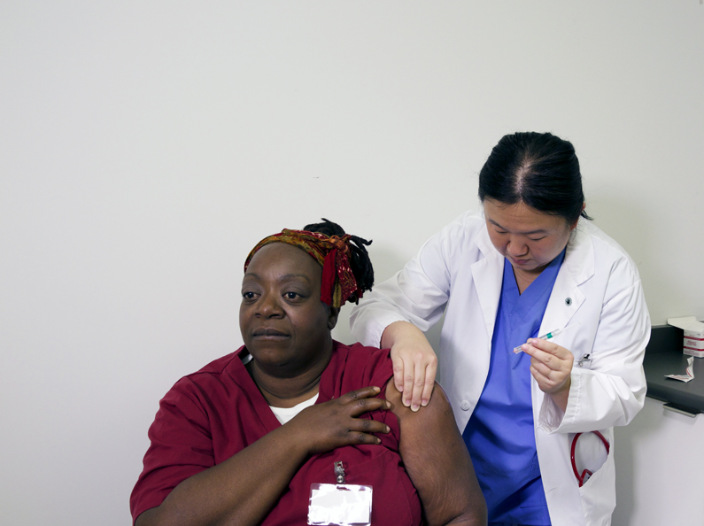
HEALTHY WORKPLACE – IMMUNIZATION PROGRAMS
Health care providers should:
have up-to-date immunizations or evidence of immunity
receive annual influenza immunization
have appropriate immunizations for the type of work they will be doing
know how to access immunizations
Notes:
Front-line health care providers should have up-to-date immunizations or evidence of immunity.
Annual influenza immunization is strongly recommended as it protects health care providers their client/patients/residents and family members.
Different health care provider roles may require different immunizations. For example, housekeepers may need different immunizations than medical laboratory technologists. Refer to your occupational health and safety resources for more information.
If your health care setting does not have an Occupational Health department, you will need to know where to go to get the immunizations you require.

Slide 17
Discussion
What immunizations do you need to protect yourself and your clients/patients/residents, and where will you receive those immunizations?

Slide 18
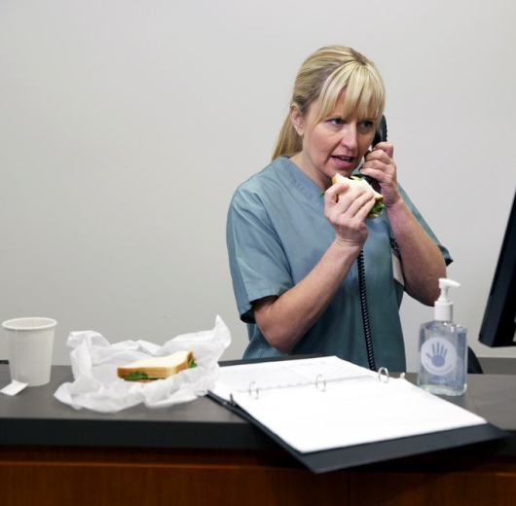
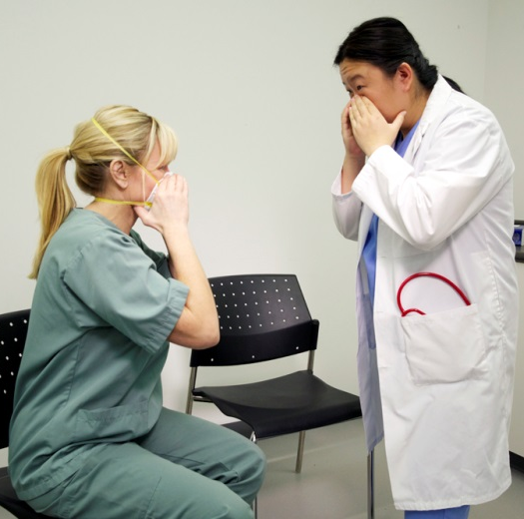
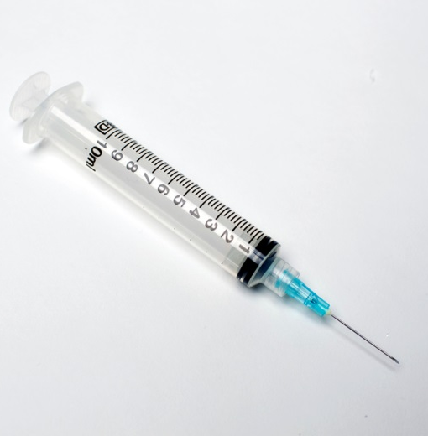
HEALTHY WORKPLACE – OCCUPATIONAL HEALTH AND HYGIENE
Occupational health and hygiene includes:
restricting where food and drinks may be consumed
a respiratory protection programs
respiratory etiquette
a sharps injury prevention program
Notes:
Occupational health and hygiene includes restricting the areas where food and drinks may be eaten.
Respiratory protection programs and “respiratory etiquette”.
A sharps injury prevention program is essential to help protect health care providers and others.

Slide 19
HEALTHY WORKPLACE – EATING AND DRINKING
Health care providers who consume food or beverages in care areas are at increased risk of acquiring gastrointestinal infections with vomiting and diarrhea.
restricting where food and drinks may be consumed
Notes:
Care areas are more likely to harbour infectious agents. If you eat or drink in areas such as a patient/resident environment, a nursing station or a charting area, you are at increased risk for acquiring gastrointestinal infections.
Institutional outbreaks of infections such as hepatitis A and norovirus involving health care providers have been reported.
Food and drink should only be consumed in dedicated “clean” areas such as a staff lounge or conference room.

Slide 20
HEALTHY WORKPLACE – RESPIRATORY PROTECTION PROGRAM
A respiratory protection program is required for staff members that will be required to wear an N95 respirator (Ministry of Labour requirement).
A respiratory protection program includes:
a health assessment
N95 respirator fit-testing, according to Canadian Standards Association (CSA) standards
training in the use of an N95 respirator
a respiratory protection programs
Notes:
If you need to wear an N95 respirator, then your workplace is required to have a respiratory protection program. This is a Ministry of Labour requirement.
A respiratory protection program includes:
a health assessment
N95 respirator fit-testing, according to Canadian Standards Association or CSA standards, and
training in the use of an N95 respirator

Slide 21
HEALTHY WORKPLACE – RESPIRATORY PROTECTION PROGRAM
Health care providers should:
be fit-tested and trained in the use of an N95 respirator (every 2 years)
use the type and size of respirator for which they have been fitted
perform a “seal check” each time they wear a fit-tested respirator
be assessed by Occupational Health for alternative protection if they cannot wear an N95 respirator
a respiratory protection programs
Notes:
If your work requires you to wear an N95 respirator, you should undergo fit-testing at least every 2 years to make sure you know the type and size of N95 respirator you need, and be trained in its use.
You are responsible for using the type and size of N95 respirator you have been fitted for, using the N95 properly as you were instructed (such as performing a seal check each time you wear one) and being assessed by Occupational Health for alternative protection if you can’t wear one. Even if your health care setting does not have an occupational health department, your employer is still responsible for ensuring that you are fit-tested and you have received training in respiratory protection.

Slide 22
Discussion
In your health care setting, how would you get respirator fit-testing and training?

Slide 23
HEALTHY WORKPLACE – RESPIRATORY ETIQUETTE
Respiratory etiquette:
is a set of personal practices for health care providers and clients/patients/resident to use when coughing or sneezing
helps prevent the spread of bacteria and viruses that cause acute respiratory infections
respiratory etiquette
Notes:
Everyone should follow and promote respiratory etiquette. It helps prevent the spread of bacteria and viruses that cause acute respiratory infections.
All health care providers need to practice respiratory etiquette and help clients, patients and residents to learn and practice it, too. This is another good habit everyone should follow.
Here are some respiratory protection strategies:
turn your head away from others when coughing or sneezing
keep a 2-metre separation between you and others when coughing or sneezing
cover your nose and mouth with tissue and then dispose of tissues into waste immediately after use
clean your hands immediately after disposal of tissues
provide masks for coughing clients, patients or residents

Slide 24
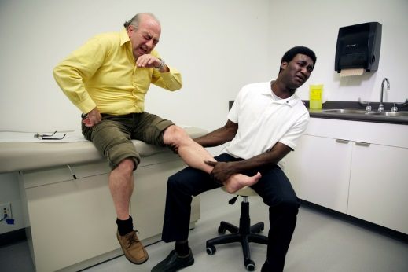
HEALTHY WORKPLACE – RESPIRATORY PROTECTION STRATEGIES
Respiratory protection strategies:
turn your head away from others when coughing or sneezing
keep a 2-metre separation between you and others when coughing or sneezing
cover your nose and mouth with tissue and then dispose of tissues into waste immediately after use
clean your hands immediately after disposal of tissues
provide masks for coughing clients, patients or residents
Notes:
Here are some respiratory protection strategies:
turn your head away from others when coughing or sneezing

Slide 25
HEALTHY WORKPLACE – RESPIRATORY PROTECTION STRATEGIES
Respiratory protection strategies:
turn your head away from others when coughing or sneezing
keep a 2-metre separation between you and others when coughing or sneezing
cover your nose and mouth with tissue and then dispose of tissues into waste immediately after use
clean your hands immediately after disposal of tissues
provide masks for coughing clients, patients or residents
Notes:
keep a 2-metre separation between you and others when coughing or sneezing

Slide 26
HEALTHY WORKPLACE – RESPIRATORY PROTECTION STRATEGIES
Respiratory protection strategies:
turn your head away from others when coughing or sneezing
keep a 2-metre separation between you and others when coughing or sneezing
cover your nose and mouth with tissue and then dispose of tissues into waste immediately after use
clean your hands immediately after disposal of tissues
provide masks for coughing clients, patients or residents
Notes:
cover your nose and mouth with tissue and then dispose of tissues into waste immediately after use

Slide 27
HEALTHY WORKPLACE – RESPIRATORY PROTECTION STRATEGIES
Respiratory protection strategies:
turn your head away from others when coughing or sneezing
keep a 2-metre separation between you and others when coughing or sneezing
cover your nose and mouth with tissue and then dispose of tissues into waste immediately after use
clean your hands immediately after disposal of tissues
provide masks for coughing clients, patients or residents
Notes:
clean your hands immediately after disposal of tissues

Slide 28
HEALTHY WORKPLACE – RESPIRATORY PROTECTION STRATEGIES
Respiratory protection strategies:
turn your head away from others when coughing or sneezing
keep a 2-metre separation between you and others when coughing or sneezing
cover your nose and mouth with tissue and then dispose of tissues into waste immediately after use
clean your hands immediately after disposal of tissues
provide masks for coughing clients, patients or residents
Notes:
provide masks for coughing clients, patients or residents

Slide 29
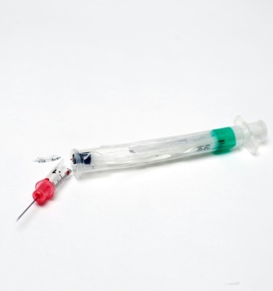
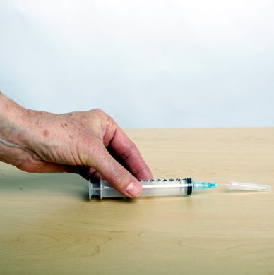
HEALTHY WORKPLACE – SHARPS HANDLING
Handling sharps safely is essential!
Sharps are objects capable of causing punctures or cuts.
A sharps injury prevention program must be in place in all health care settings.
a sharps injury prevention program
Notes:
Sharps are devices that can cause occupational injuries, such as punctures or cuts, to staff. Some examples of sharps are needles, lancets, blades and clinical glass. A sharps injury prevention program must be in place wherever health care is provided.
The law requires all health care settings to provide safety-engineered needles and puncture-resistant sharps containers at point-of-care. Refer to the component “Control of the Environment” for more information about sharps and sharps disposal.

Slide 30
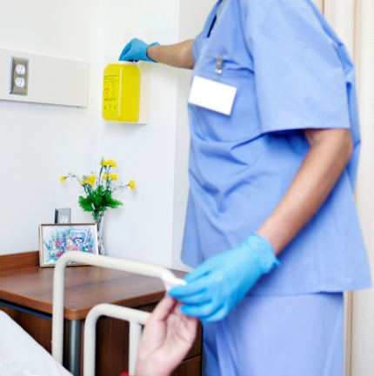
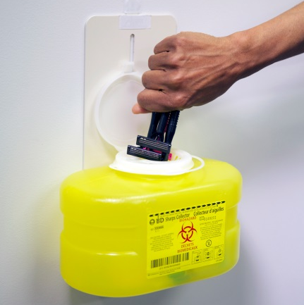
HEALTHY WORKPLACE – SHARPS HANDLING
Health care providers must:
have training and education on the proper use of needles and other sharp objects
use a puncture-resistant sharps container at point- of-care
routinely use safety-engineered needles
not fill a sharps container beyond the “fill” line
Notes:
Training and education about the proper use of needles and other sharp objects is essential for health care providers to help eliminate occupational injury from sharps.
Always make sure a puncture-resistant sharps container is available at point-of-care before you use a sharp.
Routinely use the safety-engineered medical devices that are required in all health care settings in Ontario.
Sharps containers should not be filled beyond the fill line (which is three-quarters full).

Slide 31
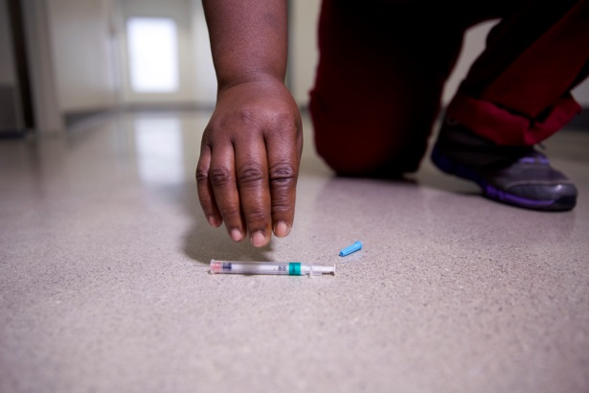
HEALTHY WORKPLACE – OCCUPATIONAL HEALTH AND HYGIENE
If a safety-engineered sharp is not available:
never recap a needle
never pick up a sharp with bare hands
always use tongs to pick up a sharp, or sweep up a sharp
Know the procedures to follow in case of sharps injury.
Notes:
When a safety-engineered sharp is not available never re-cap a needle. Never pick up a sharp with your bare hands. Always use tongs to pick up a sharp, or sweep up a sharp.
Be sure you know the procedures to follow in case of a sharps injury.
Our goal is ZERO sharps injuries!

Slide 32
Discussion
How do you handle sharps in your health care setting?

Slide 33
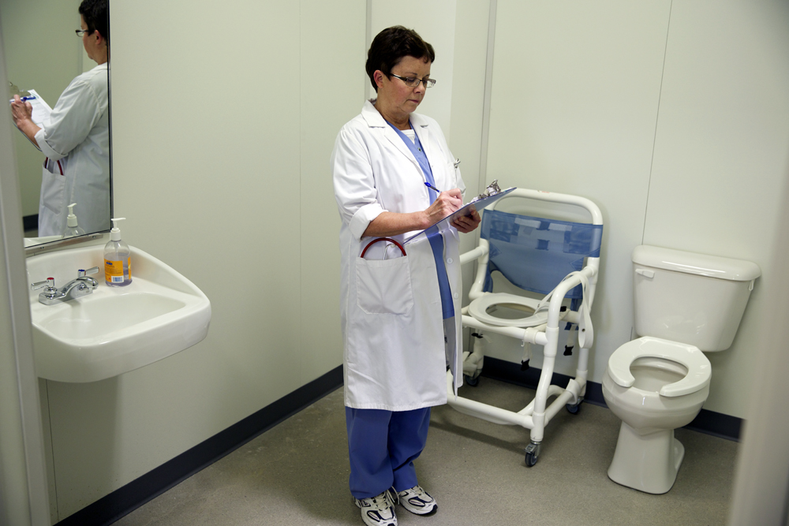
MONITORING OF COMPLIANCE WITH FEEDBACK
Monitoring of infection prevention and control programs and activities include:
audits to identify areas for improvement
ongoing assessment
feedback and evaluation
Notes:
Why do we need to monitor our infection prevention and control practices? Audits of infection prevention and control practice and education provide input towards quality-improvement initiatives and accountability in the health care setting. Audits help to identify areas for improvement to ensure the safety of health care providers and clients, patients and residents.
Assessment needs to be ongoing.
Feedback and evaluation is important to inform you about your practice and highlight areas where you and your organization can improve.
Our goal is to provide a safe environment for health care providers and for clients, patients and residents.

Slide 34
SUMMARY
Administrative Controls:
are managerial measures (such as effective policies and procedures) put in place to help reduce the risk of infection to staff or to clients/patients/residents
guide employers and workers in their roles and responsibilities
Policies and procedures that reflect evidence-based literature, legislation and best practices need to be in place in all health care settings. They need to be followed by all staff to help keep the workplace safe.
Notes:
Administrative Controls are managerial measures, such as effective policies and procedures, put in place to help reduce the risk of infection to staff or to clients, patients or residents.
They guide employers and workers in their roles and responsibilities.
Policies and procedures that reflect evidence-based literature, legislation and best practices need to be in place in all health care settings. They need to be followed by all staff to help keep the workplace safe.

Slide 35
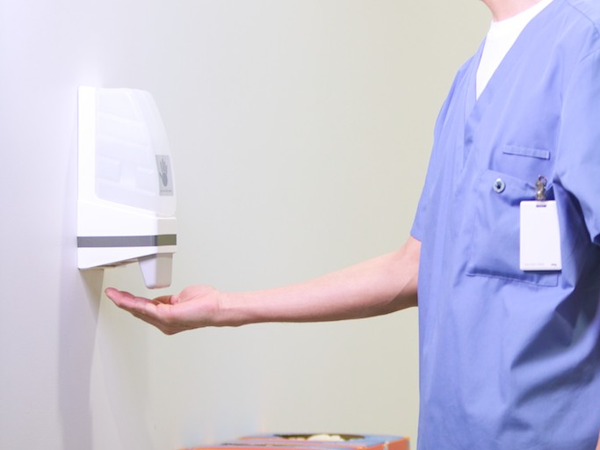
Thank you
Copyright 2014

